Slide 1
RPEL
Recognition of Prior Experiential Learning – My Experience.

Slide 2
Topics
How do we learn?
What did (APEL) RPEL look like for me?
What were my concerns?
How do I feel now?
Questions?

Slide 3
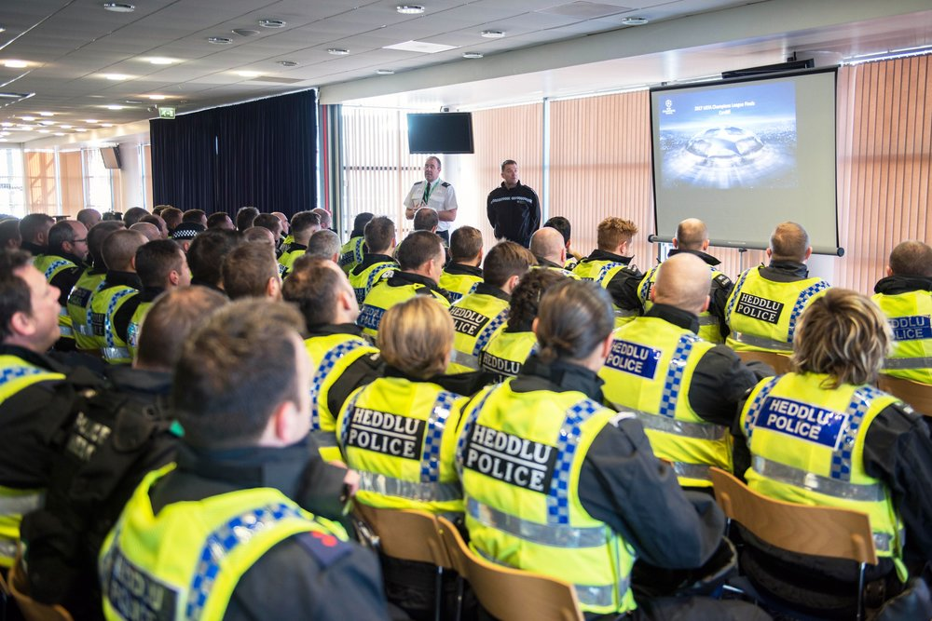
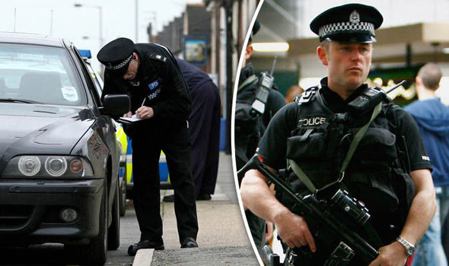
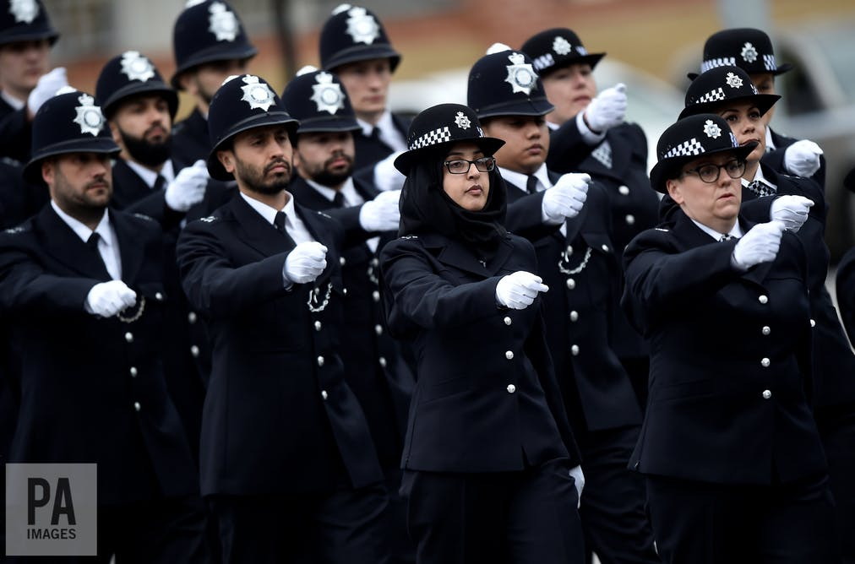
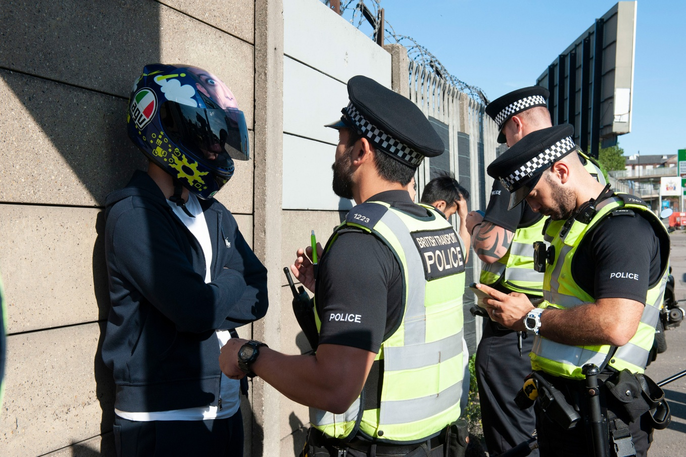
How do we learn?
Notes:
Addressing the difference between theory and practice.
Acknowledging the wealth of knowledge experience and practice brings to the field.
Addressing the changing picture of police/academia collaboration

Slide 4
What did my work look like?
No idea on referencing
Waffled
Had no structure
Operational focus
Showed ability to rationalise
Illustrated decision making
Evidenced research
Showed an ability to look at all sides.
Terrible
Notes:
Far more accessible in terms of cost, time elapsed since study, and work/life balance.
Re-affirming the CoP stance that PEQF and associated academic programmes focus on accrediting existing skills of critical thinking and research as well as honing core skills and dispelling myths.

Slide 5
What were my concerns?
18 years out of study
Recognised ‘uniqueness’ of MPS learning/exams
Difficult work-life balance
What was I going to achieve at the end of it?
Would my vocational experience stand up to assessment?
Was I good enough?

Slide 6
How do I feel now?
Greater depth to knowledge
Affirmed some principles I hid previously
Dispelled some of the myth I had bought in to
Learned life skills around critical evaluation
Professionally developed
Progressed with learning rather than accreditation
Never lost the importance of vocational understanding

Slide 7
Questions?

