Slide 1
Dr Emma Williams,
Director of the Canterbury Centre for Policing Research
School of Law, Criminal Justice & Computing
Canterbury Christ Church university
Emma.williams@canterbury.ac.uk
PD for BSc jenny.norman@Canterbury.ac.uk
@emwilliamscccu (Twitter)
16th May 2019
Notes:
Introduce – not a sales pitch
Lack of knowledge about the options for already serving officers through the PEQF
Welcome – who we are and time delivering degrees for officers

Slide 2
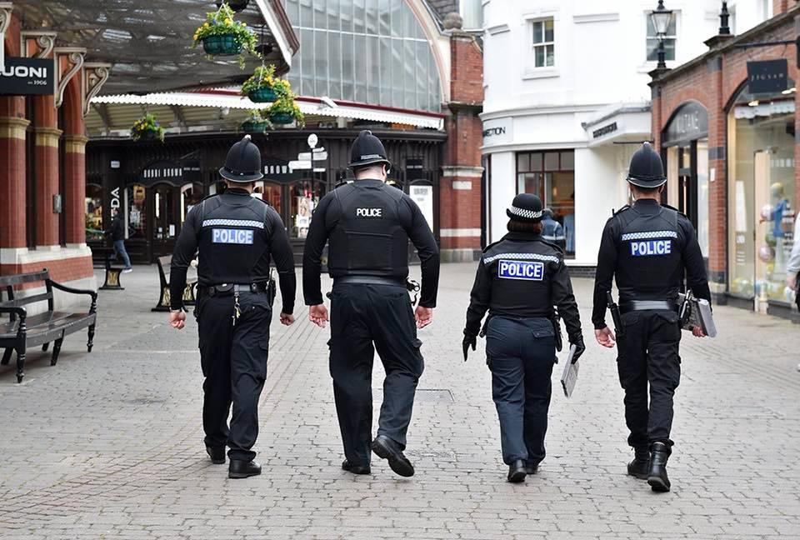
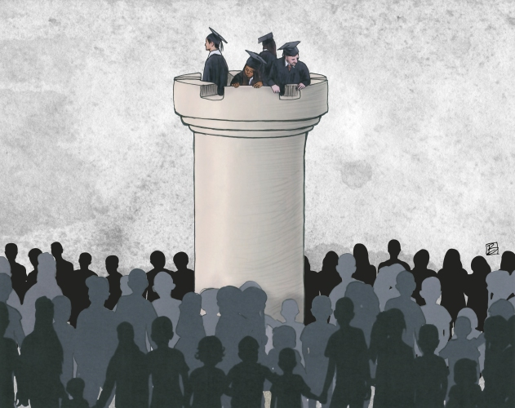
Dispelling some myths: Keeping it real…….
Ivory tower v police work
Notes:
RECOGNISING prior experience in the awarding of academic credits is essentially about applying your practical experiences and current training and having them recognised as equivalent to certain levels of academic learning.
It is about valuing your practical and real life experiences of police work through formal qualifications which could be used outside of the job. This knowledge can be put towards a degree programme or other qualification and you could essentially complete a programme in less time that would normally be possible – for example….
Doing an academic programme as an officer is not about academics suggesting that classroom knowledge is more worthy than practical knowledge – it is about using the two levels of knowledge together to allow for new thinking alongside craft learning by reflecting on these new types of knowledge in your operational and strategic decision making

Slide 3
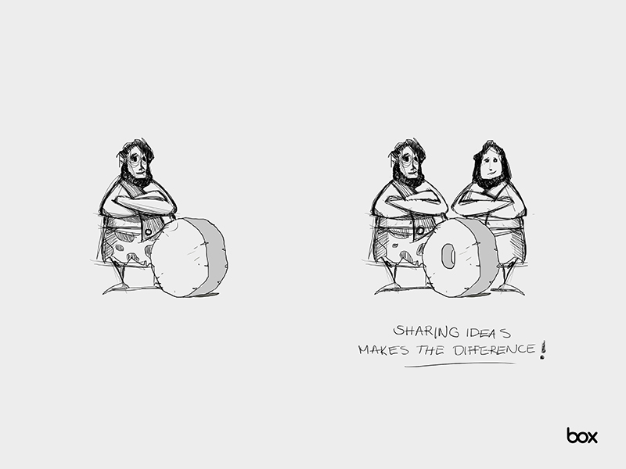
What do we gain as academics????
Reciprocal learning (we hope!)
What do we gain as academics????
Reciprocal learning
Notes:
Having officers on our programmes is great for us
We also learning from practitioners on the courses – it helps us to understand the context of theory in practice / develop new ideas for research and also understand the reality of demand on police in the current and changing climate
Therefore we hope we can think better about how our teaching can be developed in an applied way to expand on the experience you already hold
It is not our role to make you a professional – policing is already that - but we hope to be able to give you some context as to why you do what you do / what drives some of what you deal with and what thinking might help you deliver better outcomes in the future …

Slide 4
Overview of the BSc Programme Programme Director Jennifer Norman
6 year part-time degree programme
Completed in three years of part-time study because of……
3 years worth of RPL
Combination of academic essays / task of reflective practice and applied papers in the assessment process to recognise the diversity of knowledge used in police work
Successful students qualify with a BSc (Hons) Policing
Notes:
Just to reiterate this is not a sales pitch but our undergraduate in service programme can give you a flavour of what a police course might look like.

Slide 5
Why our students want to study on this programme…
We ask students THEIR views on the programme throughout their time with us in varied ways – informally conversations, through one-to-one sessions, via reflective exercises, from formal module feedback forms, student surveys… THIS is what our students tell us!
Top three reasons why our students want to study this degree:
To attain a degree level qualification
To challenge themselves
To acquire specialised police-specific knowledge
Our students want to use the learning from the degree to:
1) Understand the wider context of different policing issues
2) Think about alternative ways of doing things
3) Use their learning to support their decision-making at work
confidence about the knowledge brought to their role
Notes:
Thankful to say that these aspirations of our students in terms of what they want to get from learning with us match what we are trying to achieve…. Not about being a more professional cop but about
1 2 and 3
I suspect it is the same in other establishments also
So this is a little background on our specific experience with officers and staff and I will now hand over to …. Who will discuss….

