Slide 1
The National Police Library: Today’s Overview
The physical library at Ryton
Library resources and services
How to join the library
Contact us
Any Questions?
Angel Egbuji
Notes:
National Police Library was est. in June 1948 for Senior Police Officers.
Moved to Bramshill 1960 and then became the National Police Library for all police officers
Moved to Sunningdale March 2015
February 2017 relocated to Ryton - complete new library team

Slide 2
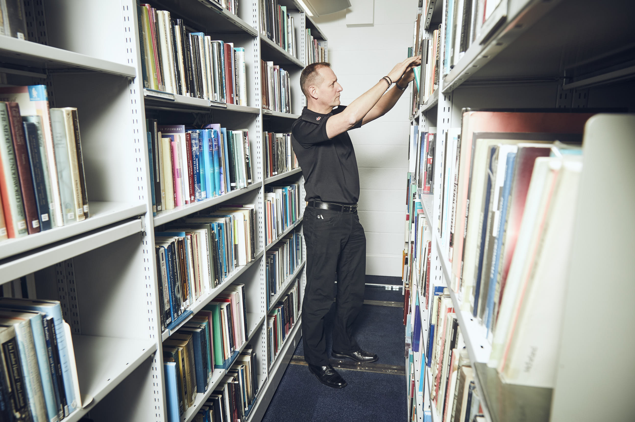
Access to library, resources and services
Library Opening Times
Loans
Document Supply and Enquiry Service
Join NPL - https://www.college.police.uk/What-we-do/Research/Library/Pages/default.aspx
Notes:
Opening times
Monday - Thursday 8:30am – 5:00pm
Friday 8:30 – 4:00pm
Free access to all serving police officers and staff who are college members, we are the largest police library in Europe.
Print and electronic resources - Hold over 10 thousand journal titles and over 65 thousand books in all aspects of policing including criminology, research, leadership and management. Access to hard copy journal titles. Can photocopy journal articles on site (10% = 1 article subject to Copyright Laws)
Specialist information – Police Gazette, Police Professional; Gray literature reports from forces, Home Office, ACPO, Charities
Catalogue accessible online – print request via catalogue – postal loan. Online renewal not possible - phone or email us.
Up to 10 items can be borrowed.
Reading and study space available - You are welcome to visit, we love seeing people so do visit. Inform us before hand though and bring your police ID with you.
If doing a residential course at Ryton, you can use the library outside of opening hours. Arrangements by appointment only
To join
Fill out the NPL registration form and email it back to us. We will register you with the library and email you with the your OpenAthen and Heritage login details. This will then allow you to access the Police Library Search and Heritage Online (National Police Library Online.
Enquiry Service
Enquiry service on offer – You can email, phone, use ‘Ask a librarian ‘or visit.
Support for studies, personal research, work enquiries, historical inquiries. We support/supported inquests, Hillsborough disaster, undercover policing, Manchester bombing.
Provide advice on systematic searches and help develop search criteria.
You can sign up to ‘library update’ email list and you will be emailed with the monthly library information containing new additions to collections and library highlights.
Training – library inductions, information skills and more in-depth searching skills on and off site.

Slide 3
Online Presence: Police Library Search
Notes:
This is accessible via OpenAthens – a password authentication gateway for our e-resources. Every member of the library will have an OpenAthen’s login which will be given to them when they register.
PLS –
a single search interface that conducts rapid search across all the journals and databases we subscribe to
Contains thousands of journal and newspaper articles and multimedia records
It pulls resources from our classic catalogue as well – National Police Library Online
From PLS, you can access:
National Police Library Online
EBSCO Host – within ebsco we subscribe to 3 database:
Criminal Justice Abstract – Abstract records in criminology, criminal justice, criminal law and procedure, corrections and prisons, police and policing, forensic sciences, etc. Over 270 full text journals included.
PsycInfo – owned by the American Psychological Association – abstracts or peer reviewed literature in behavioural science and mental health. We have access to records from the 1800s to the present.
Psychology and behavioural scinces collection – full text psychology database covering over 500 journals
Proquest – full text – education, political science, social science and sociology
Emeraldinsght – leadership and business management, social sciences, public policy and education
Web of Science – abstracting and indexing database – life sciences, sciences, social sciences, arts and humanities. Searches over 120,000 journals

Slide 4
Searching NPL
https://login.openathens.net/
https://www.openathens.net/

Slide 5
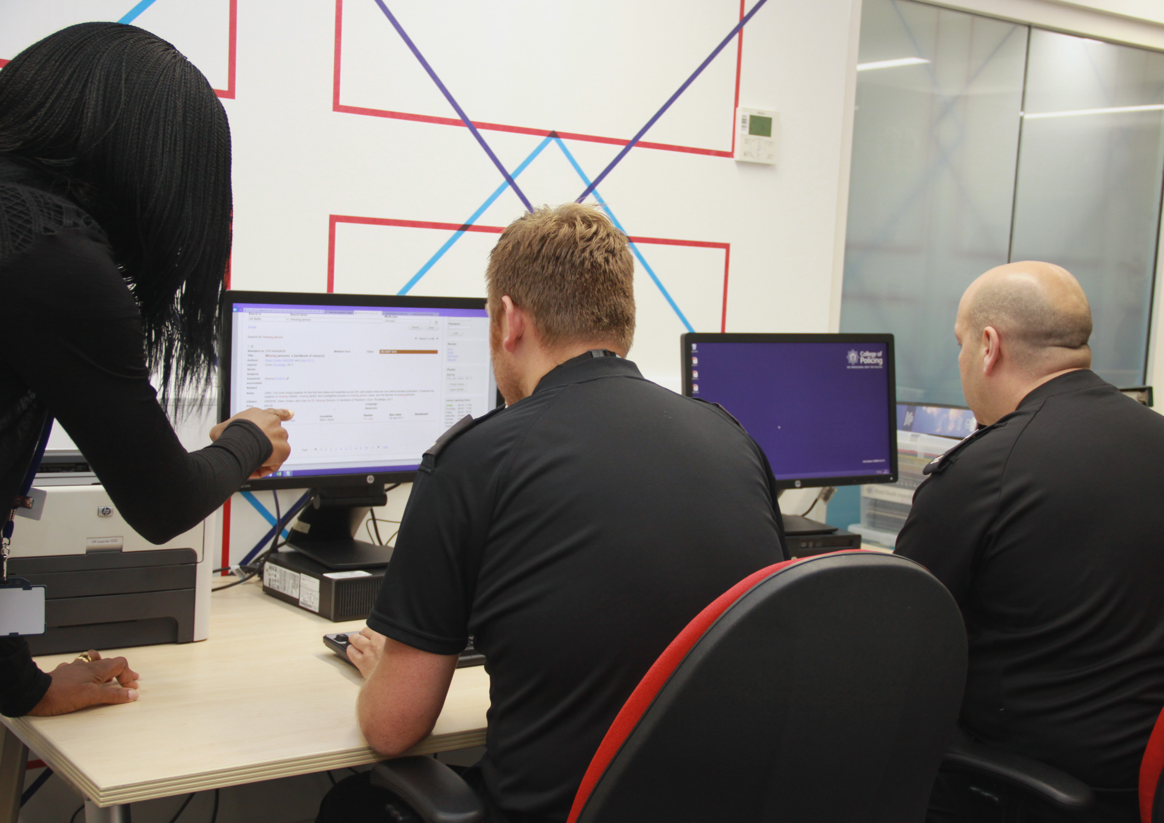
Need help? Do contact us!
Notes:
Can’t find what you’re after? Feel free to ask us for help with searching!
Do we have anything similar that might be useful?
Is there something you think we should have in stock but don’t? Tell us about it!

