Slide 1
Scott Clarke
Police Constable Degree Apprenticeship(PCDA) Programme Leader

Slide 2
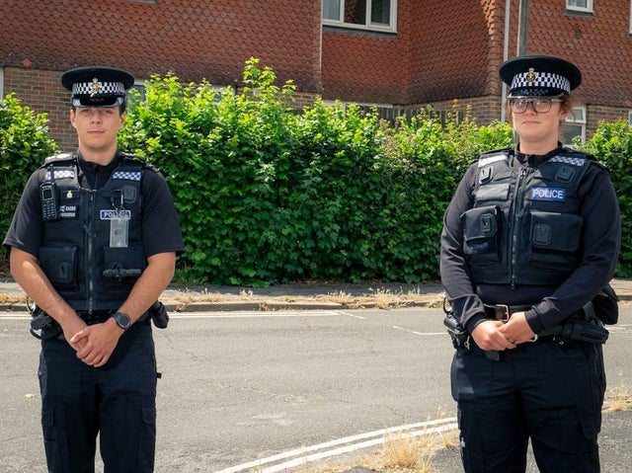
Presentation Topics
HEI/Police Partnership Working
Police Constable Degree Apprenticeship (PCDA)
Student View
Theory into Practice
References
sussexexpress.co.uk

Slide 3
HEI & Police Partnership Working
4 HEIs
3 Police Forces
Consistent Approach
Curriculum Group
Police Foundation Trainers
Police Coaches
ww.nhsmidandsouthessex.co.uk

Slide 4
Police Constable Degree Apprenticeship
What does it mean to be a Police Constable?
History
Legislation
Procedures
Theory
Context

Slide 5
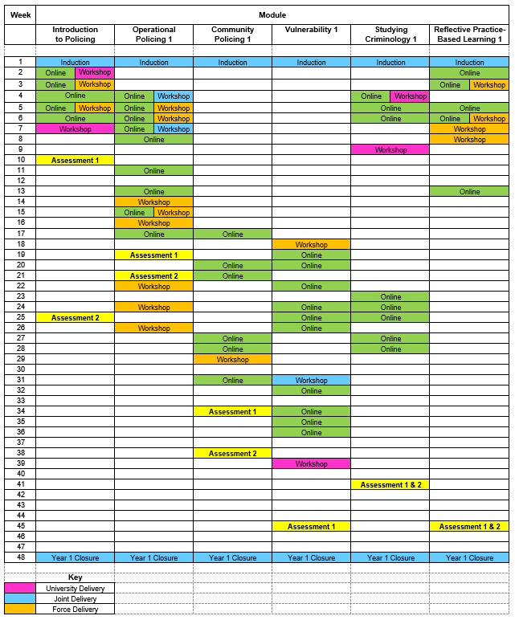
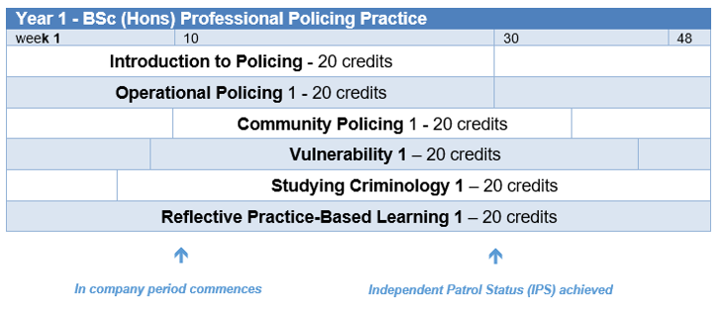
Police Constable Degree Apprenticeship

Slide 6
Police Constable Degree Apprenticeship
ICE-C
Face-2-Face v Online
Class Sizes
Online Assessment
Tri-Partite Reviews
Introduce
Confirm
Explore
Consolidate
(Jones, 2020)

Slide 7
Police Student View
‘I found all the operational policing elements very useful. I find the reviews good with my tutor and the university useful, as you get both sides of the input. The workbooks are really good and try to encourage you to go into more further reading.’
‘Face to face Inputs, role plays, case studies and class discussion. Hearing real examples to base our learning on has been a real help at confirming our understanding.’
‘I have particularly liked the online work book. Because it has been a perfect tool to helps us during the lockdown. It was so beneficial to us as students. It allows you to work and study from anywhere.’
‘Face to face lessons/sessions. Good quality reviews as they make me feel supported by the university & police trainers.’

Slide 8
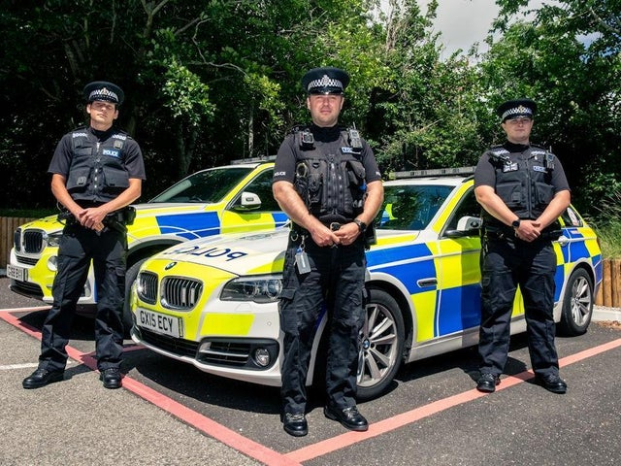
Theory into Practice
Fellow Eastbourne and Wealden new recruits were just hours into their first shift, in June, when they and their coach were called to reports of an assault in Eastbourne.
“I was nervous,” an officer who had served in the army before joining the police said, “but once we arrived on scene, I found all the training and knowledge had sunk in.
sussexexpress.co.uk

Slide 9
References
Butler, J. (2020, July 9). New East Sussex police recruits share stories of first days in the job. New police recruits in East Sussex have shared stories of their first days in the job. Sussex Express. Retrieved from https://www.sussexexpress.co.uk/news/crime/new-east-sussex-police-recruits-share-stories-first-days-job-2908332 (Accessed: 10 July 2020).

