Slide 1
Skin coloured targets
An exploration of how they are perceived by frontline officers with regards to procedural justice

Slide 2
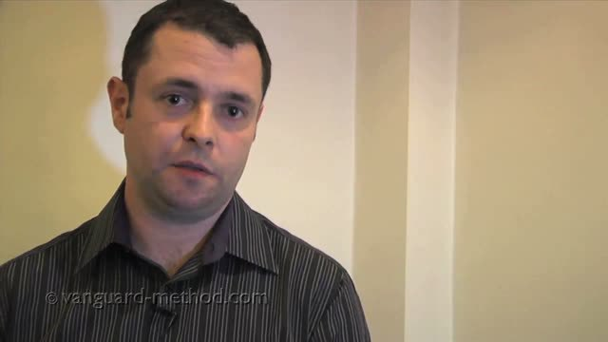
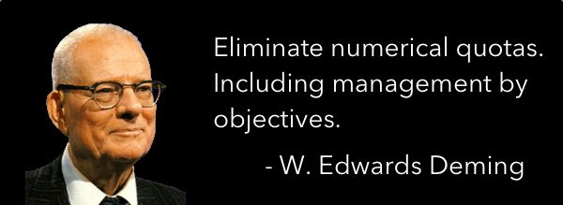
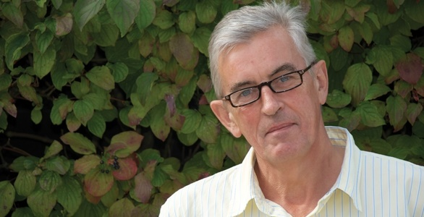
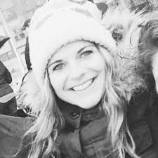
How did I come to be here?

Slide 3
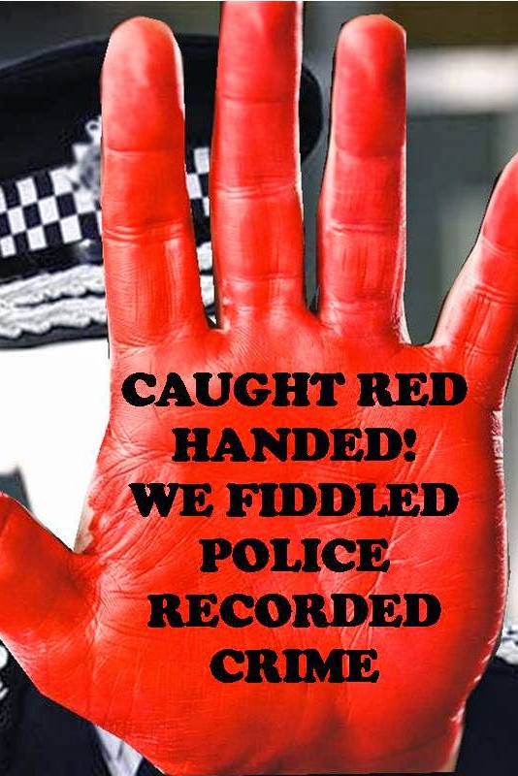
What do targets do, when you apply them to people, and not crime reports?
We know that there are unintended consequences of the use of targets in crime recording.
We know that this doesn’t just exist in the police context, but in many other contexts across many industries.
We know that there are recruitment targets for members of the BME community throughout policing.
What are the internal unintended consequences that we can’t see?

Slide 4
How? What evidence would I consider?
Qualitative study
Frontline uniform officers
23 completed interviews, 17 transcribed – I stopped at what I thought was saturation
Thematic coding
Open ended, semi structured interviewing which allowed the subject to guide the content.
I did a lot of listening

Slide 5
Coding & Nodes
Culture
Representation
Questions around targets
Negative perceptions around targets
Competence
Positive Action as viewed by the frontline

Slide 6
The good news…
One of the highest frequency nodes
Often repeated between candidates
Strongly linear in representation
Officers strongly believe that the service has to become more representative

Slide 7
Questions…
One of the biggest nodes represented consistent questions about why targets and positive were necessary?
Why were they used?
What is it there to achieve?
What about competence..?

Slide 8
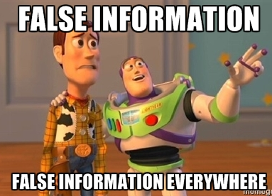
Decision making in the police hierarchy
Linked nodes often led to a lack of understanding, which resulted in questions…
These questions were valid
There was no passage or avenue for information between management/hierarchical decision making, and those that worked with the results of the decisions made.
The informational justice in Tyler and Blader’s Procedural Justice model (2003) was simply absent.

Slide 9
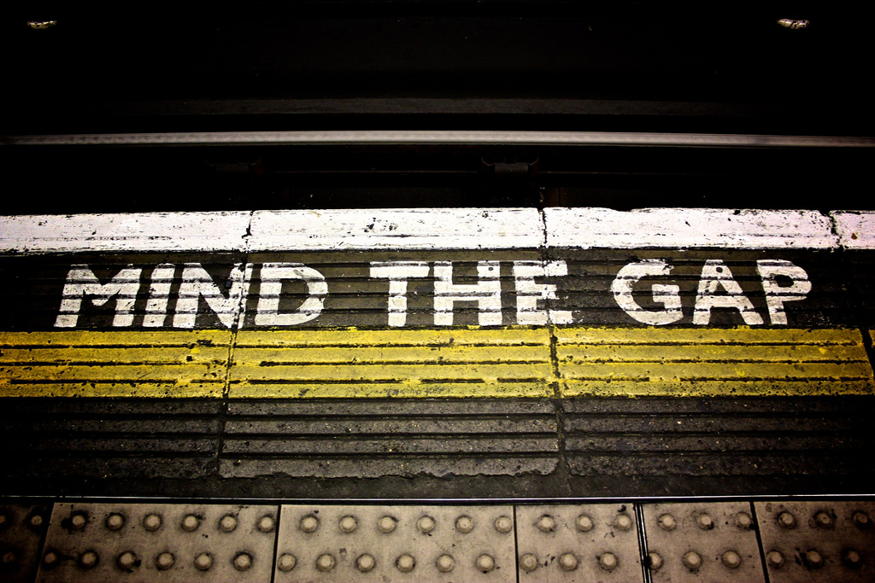
Outcomes of this lack of informational justice?
Culture fills the gaps
cynicism
suspicion
defensive
insular

Slide 10
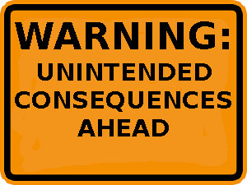
Ultimately
BME officers who are recruited or selected receive a covert questioning of their competence.
Are they there because of the targets, or are they there because they can do the job?
Were they really as good as the other candidates?
Did better people choose not to apply?

Slide 11
Making informed decisions…
With these consequences in mind, is using targets within the policing environment, conducive to solving the problem for which they were designed?
Are targets and the methods of managing them not just frustrating purpose, but actively working against it?
If the theory of procedural justice is followed through, what are the wider consequences of the use of these targets?

Slide 12
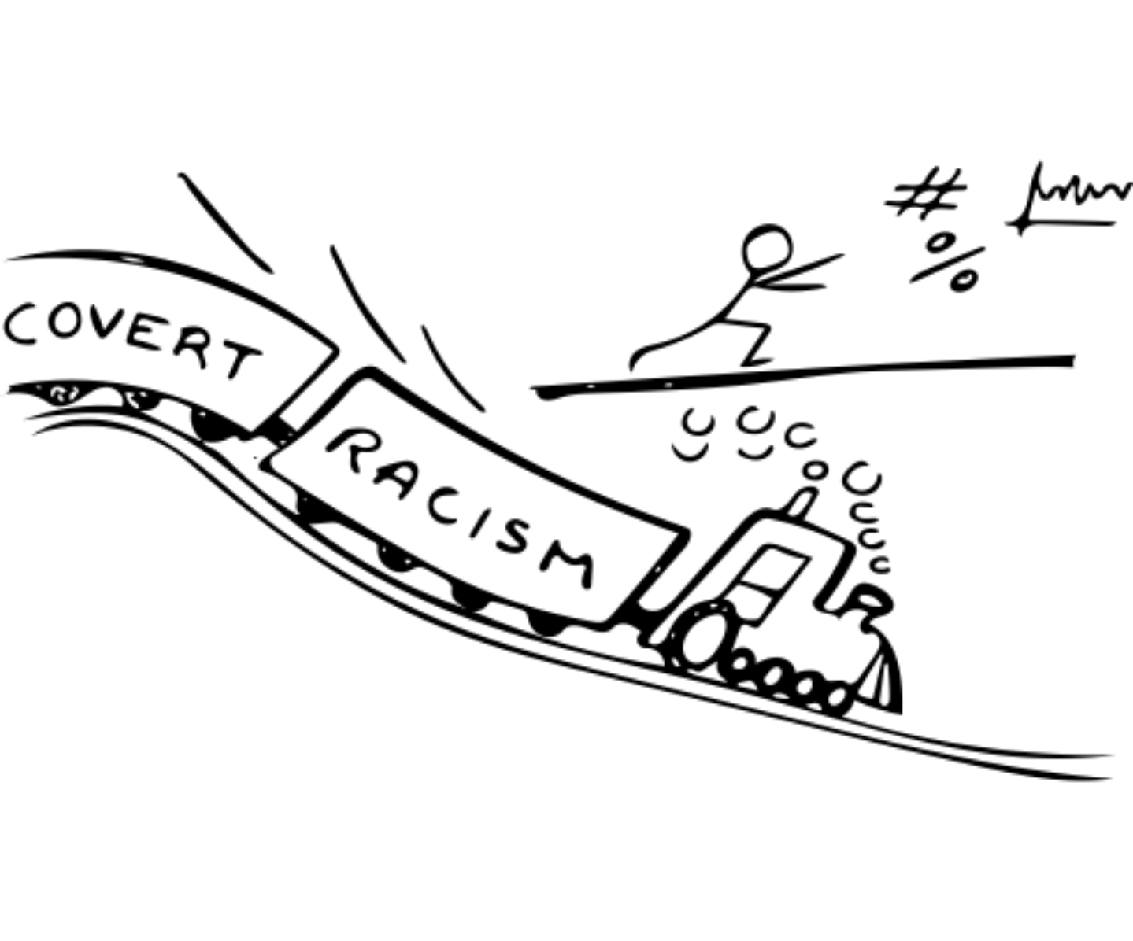
Is it possible that our current methods of approaching diversity not only do not help to solve our problems, but actually contribute to them?

Slide 13
Looking ahead…
Far more research is necessary to understand the problem that we are trying to solve.
Is representation really about numbers? Or is it about legitimacy – confidence and trust in particular?
When we reach ‘reflection’ is the representation ‘problem’ solved?
Why do under-represented groups not want to join the police?
Are our current processes really up to the job? Why do we need positive action in the first place?
We MUST get better at engagement as a service.

Slide 14
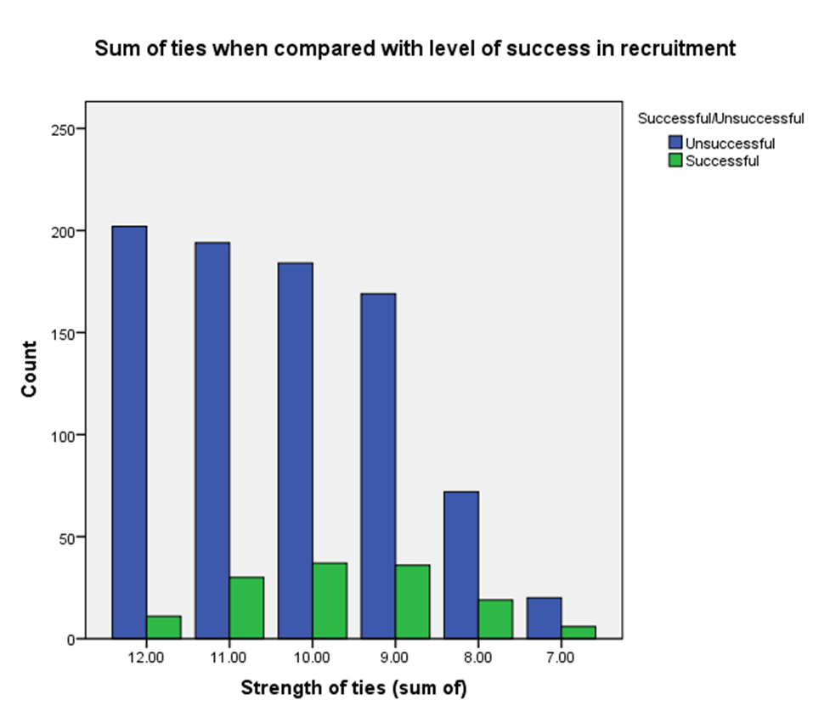
A sneak peak…

Slide 15
Any questions?
@dedicatedpeeler
garethlstubbs@gmail.com

