Slide 1
Are UK universities more ethical than police organisations? 4th Annual CCPR Conference ‘Austerity and Ethics: a paradox for professionalism’ Richard Heslop, Bournemouth University, UK 19 – 20 June 2019
Notes:
NEXT SLIDE

Slide 2
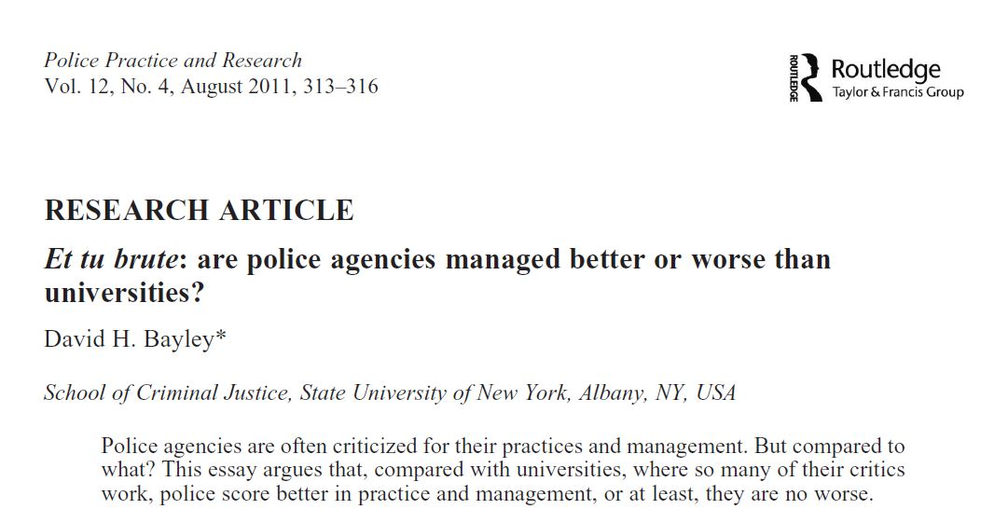
Notes:
NEXT SLIDE

Slide 3
“I just had to get this off my chest. Academics talk about how the police need to change, but guys, have you thought about where you are working? Give us a break”. Professor David H. Bayley (quoted in Heslop, 2015: 522)
Notes:
NEXT SLIDE

Slide 4
Bayley focussed briefly on the topic of university ethics and values. Raising concerns about:
Inappropriate staff and student sexual; relationships on campuses;
Sexual harassment;
Unequal treatment of female students;
Racial discrimination.
Notes:
NEXT SLIDE

Slide 5
“Universities give less attention to the discussion of values and the ethical dilemmas of their work than the police”.
(Bayley, 2011:315)
Notes:
NEXT SLIDE

Slide 6
Rationale for current comparison
University academics at forefront of researching some of the more unethical dimensions of policing. Some of the most prominent critics of the police (Bayley, 2011).
Numerous research collaborations between police and academic community (Loftus et.al, 2014). Police likely to rely heavily on research ethics expertise/protocols of academic partners.
Under the Police Education Qualifications Framework (PEQF) universities will be key actors in police education (COP, 2019).
Notes:
NEXT SLIDE

Slide 7
PEQF
Three police constable entry routes from 2020
Pre-join (self funded) professional policing degree;
Police Constable Degree Apprenticeship (PCDA);
Two year conversion degree for existing graduates.
(COP, 2019)
Notes:
NEXT SLIDE

Slide 8
Rationale for changes to police education include:
Professionalise the public police (COP, 2019);
In the context of austerity the ‘dominant approach’ to understanding PEQF is in ‘fiscal terms’ (Wood, 2018);
Improve ethical standards;
Weaken/disrupt police culture socialisation processes.
Notes:
NEXT SLIDE

Slide 9
Police Ethics
In last decade, significant concern and developments surrounding police ethics.
Influenced by two broad themes:
Series of high-profile misconduct and corruption cases involving all echelons of the public police.
Police professionalisation agenda.
Notes:
NEXT SLIDE

Slide 10
Police Ethics
From the earliest days of formation of ‘modern’ policing in eighteenth century to the ‘Plebgate’ scandal of more recent times, UK policing littered with cases of misconduct.
Relatively recent cases include:
West Midland Serious Crime Squad
Birmingham Six
Guildford Four
Carl Bridgewater case
Steven Lawrence murder investigation
Phone hacking scandal.
Notes:
NEXT SLIDE

Slide 11
Themes within the academic literature include:
Racism (i.e. Hall et al., 1978)
Sexism (i.e. Brown, 1998)
Use of force (i.e. Waddington & Wright, 2008)
Police/media relationships (i.e. Mawby, 2010)
Corruption (i.e. Newburn, 2015)
Covert policing (i.e. Loftus et al., 2016)
Police Ethics (i.e. Westmarland & Rowe, 2016)
And an extensive body of empirical research literature drawing on concept of police culture (i.e. Loftus, 2008).
Notes:
NEXT SLIDE

Slide 12
Police Ethics
In the last decade, many of the cases relate to the misconduct of not only rank-and-file officers but:
Senior officers including numerous Chief Officers (COP, 2015)
Police Federation (House of Commons, 2014)
Police & Crime Commissioners (The Telegraph, 2014).
Notes:
NEXT SLIDE

Slide 13
While some of the recent cases can only be categorised as corruption/criminality, others take us into the more ambiguous territory of police ethics.
“The simple but uncomfortable fact is that complex ethical problems are an inherent part of policing”
(Newburn, 2015:1) .
Notes:
NEXT SLIDE

Slide 14
Code of Ethics for the policing profession
Moral panic over these and other incidents partly responsible for College of Policing introducing a formal Code of Ethics for the police in 2014.
Though a further key driver was the police professionalisation agenda, specifically the perceived lack of a formal ethics code.
Notes:
NEXT SLIDE

Slide 15
Graduate policing
“The empirical evidence base is not strong enough to draw definitive conclusions about the more specific graduate attributes bring to policing and this is particularly the case for the UK based research”
(Brown, 2108: 11).
While policing degree programmes seem to “confer no particular advantage to police officers” it is their “experience of university per se” that seems to be important
(ibid:1)
Notes:
NEXT SLIDE

Slide 16
Universities
In recent years an increasing number of UK universities, academics and students have faced critique and censure in relation to a range of unethical practices.
Controversies have occurred against a background of three decades worth of macro-level changes within higher education (HE) sector, which have been comprehensively documented and critiqued within the adult education literature.
Notes:
NEXT SLIDE

Slide 17
In particular, a large critical literature has developed on the increased marketisation of HE and associated themes such as:
Rise of performance management and academic performativity (i.e. Ball 2012)
Students as consumers (i.e. Molesworth at al., 2011)
Commodification and devaluing of HE (i.e. Collini , 2012,2018)
Notes:
NEXT SLIDE

Slide 18
Academics are accused of having become “deprofessionalised” (Morrish, 2015) and universities are becoming “universities without integrity” as their “inner calling are emptied out to be replaced by the callings of others” (Barnet, 2003, 71).
Notes:
NEXT SLIDE

Slide 19
“…genuine academic freedom in British universities is in a parlous condition. Not because uniformed commissars are frog-marching outspoken academics off to jail (not that there are that many outspoken academics in the first place). It is more a matter of the daily erosion of intellectual integrity…”
(Collini, 2018)
Notes:
NEXT SLIDE

Slide 20
Not only intellectual integrity under threat
While many of the problems are interrelated we may classify them under a number of broad themes.
Institutional/leadership
A few bad apples or academic culture?
Student cultural
Notes:
NEXT SLIDE

Slide 21
“I didn’t go to university to pay a Vice Chancellor £800,000”
(university student, quoted in New Statesman, 2017)
Notes:
NEXT SLIDE

Slide 22
Institutional/leadership
“Scandals aren’t meant to happen in British universities. Parliament, tabloid newsrooms, the City … those we expect to spew out sleaze…Yet we should all be scandalised by what is happening in academia. It is a tale of vast greed and of vandalism – and it is being committed right at the top…
If this were just about individual greed, we could sling out a few bad apples and carry on. But what’s rotten in universities is the rules observed by the people at the top”
(Chakrabortty, 2017)
Notes:
NEXT SLIDE

Slide 23
In an age of tuition fees university VCs are becoming “figures of hate and symbols of institutional greed”.
(New statesman, 2017)
Notes:
NEXT SLIDE

Slide 24
Institutional/Leadership
University tuition fees system, which now borders on a financial mis-selling scandal (National Audit Office, 2017).
Third of students did not think course provided value for money and many may not realise their degree many not lead to a well-paid job.
Example last week of Anglia Ruskin graduate who received a £60,000 pay-out from the university insurers after claiming university “exaggerated the prospects of a career” (BBC,2019a)
https://www.bbc.co.uk/news/uk-48490572
Notes:
NEXT SLIDE

Slide 25
A few bad apples or academic culture?
Recent concerns, for example, over:
“Culture of cruelty” in UK Universities involving extensive levels of bullying and harassment of staff (i.e. UCU, 2012; Farley & Sprigg, 2014).
Sexual misconduct by university staff at ‘epidemic levels’ (Batty, et al., 2017).
Transparency: extensive use by universities of non disclosure agreements (gagging orders’) to cover the problems up (BBC, 2018)
Notes:
NEXT SLIDE

Slide 26
Student Cultural
Racism on campuses. A 2011 report by NUS identified that one in six black students experienced racism at their institution. NUS President Shakira Martin quoted as saying “universities are more concerned about their reputations than confronting racism” (BBC 2018).
“Lad cultures” on campuses (Philips & Young, 2013) and high incidences of student-on -student sexual assaults and harassment. Also described as an “epidemic” (Time Higher Education).
Even suggestions of a “rape culture” on some campuses, particularly following the screening of the BBC3 documentary ‘the Warwick uni rape chat scandal (BBC, 2019b).
https://www.bbc.co.uk/news/uk-48366835
Notes:
NEXT SLIDE

Slide 27
“Rape the whole flat to teach them a lesson”; “Oh god. I would hate to be in the firing line if I had a vagina”; “I swear to god if it's that girl in my flat, I'm going to go all 1945 advancing Soviet Army on her and rape her in the street while everybody watches”; “Rape her and run”
(BBC, 2019b)
Notes:
NEXT SLIDE

Slide 28
To conclude
Notes:
NEXT SLIDE

Slide 29
Thank you
Possible discussion/questions:
If police recruits can be socialised into problematic cultures and ways of behaviour within the highly disciplined/regulated confines of a police academy, then why not on a university campus?
Are there occasions when police scholars/criminologists should look at some of the problems in their own back yard?
Are UK universities more ethical than the police?
Notes:
NEXT SLIDE

Slide 30
References
Barnett, R. (2003). Beyond all reason: Living with ideology in the university. Buckingham: Open University Press
Bayley, D, H. (2011). Et tu brute: are police agencies managed better or worse than universities? Police Practice and Research: An International Journal, 12(4), 313-316.
BBC (2018). ‘Universities more concerned about reputation than racism’. Available at: https://www.bbc.co.uk/news/education-43555737 [Accessed 1/6/2019].
BBC (2019a). ‘Graduate gets £60k payout over 'false advertising' claim’. Available at: https://www.bbc.co.uk/news/uk-48490572 [Accessed 4/6/2019]
BBC (2019b). The Warwick Uni Rape Chat Scandal. BBC3 shown on 28/5/2019.
Brown, J. (1998). Aspects of discriminatory treatment of women police officers serving in forces in England and Wales.
British Journal of Criminology. 38(2), 265-282.
Chakrabortty, A. (2017). The fat cats have got their claws into our universities and will eat them up. The Guardian, (28/11/2017).
Collini, S. (2018). In UK universities there is a daily erosion of integrity. The Guardian. (24/4/18)
(COP) College of Policing (2019). Entry routes for police constables. Coventry: College of Policing.
(COP) College of Policing (2015). Chief Officer Misconduct in Policing: an exploratory study. Coventry: College of Policing.
(COP) College of Policing (2014). Code of Ethics. A code of practice for the principles and standards of professional behaviour for the policing profession for England and Wales. Coventry: College of Policing.
Hall, S., Critcher, C., Jefferson, T., Clarke, J. and Roberts, B. (1978). Policing the Crisis. London: Macmillan.
Heslop, R. (2015). The contribution of David H Bayley, policing research pioneer. Police Practice & Research: An International Journal, 16(6) 512- 526.
House of Commons (Home Affairs Committee) (2014). Reform of the Police Federation. London: House of Commons.
Loftus, B. (2008) Dominant Culture Interrupted: Recognition, Resentment and the Politics of Change in an English Police Force. The British Journal of Criminology, 48(6), 756-777.
Loftus, B., Skinns, L., Munk, T., & Rice, L (2014). Policing Partnerships: Evidence Review. N8 Policing Research Partnership.

Slide 31
References continued
Mawby, R. C. (1999). Visibility, transparency and police‐media relations. Policing and Society. An International Journal of Research and Policy, 9(3), 263 -286.
Morrish, L. (2015). The Paradox of the under-performing professor. Academic irregularities, critical university studies, discourse and managerialism. Available at: https://academicirregularities.wordpress.com/2015/07/10/the-paradox-of-the-underperforming-professor/ [Accessed 15/4/2019]
National Audit Office. (2017). The Higher Education Market. London: NAO.
Newburn, T. (2015). Literature review – Police integrity and corruption. London: HMICFRS.
New Statesman (8/12/17). I didn’t go to university to pay a Vice Chancellor £800,000.
(NUS) National Union of Students (2011) Race for Equality: a report on the experiences of black students in further and higher education. Available at https://www.nus.org.uk/PageFiles/12355/NUS_Race_for_Equality_web.pdf. [Accessed 1/5/2019]
Times Higher Education (17/1/2018). Sexual Assault its revolting.
The Telegraph (1/12/2014) More than half of elected police chiefs investigated over allegations of misconduct.
Phipps, A. and Young, I, (2013). That's what she said: women students' experiences of 'lad culture' in higher education. Project Report. National Union of Students: London.
Waddington, P.A.J., and Wright, M. (2008). “Police use of force, firearms and riot control”. In Newburn T. (ed) Handbook of Policing. Culhompton: Willan, 465-496
Westmarland, L., and Rowe, M. (2016). Police ethics and integrity: can a new code overturn the blue code? Policing & Society: An International Journal of Research and Policy, 28(4), 854 – 870.
Wood, D, A. (2018). Embedding Learning and Assessment Within Police Practice: The Opportunities and Challenges Arising from the Introduction of the PEQF in England and Wales. Policing: A Journal of Policy and Practice. Published on-line 7 December 2018.

