Slide 1
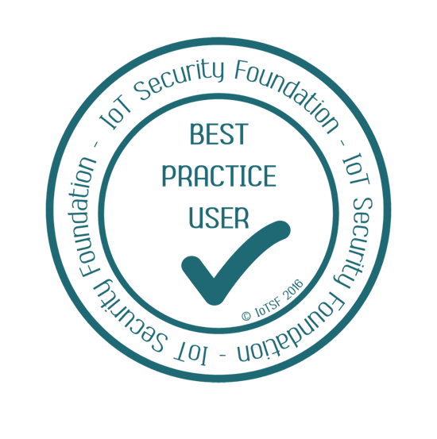
How we can build secure IoT devices to meet the new legislative challenges January 2020
Haydn Povey – CEO & Founder
haydn.povey@securethingz.com
Founding Member
Third Annual Cyber Conference
Cyber Innovation Hub of Canterbury Christ Church University

Slide 2
Driving Security Best Practices
IoT Security Foundation www.iotsecurityfoundation.org
Working Groups
Self Certification – Enabling OEMs to rapidly certify products
Trustmark – Effective communication of trust & confidence
Compliance Validation & Test – Ensuring devices meet formal test
Update & Patching Best Practice – Delivering updates to constrained devices
Vulnerability Disclosure – Best practices to identify and manage exploits
Connected Consumer Products – Evolving consumer devices
And many more …

Slide 3
The State of IoT - Enabling Market Growth
Security is now the leading barrier for IoT adoption*
> 70% of enterprise customer say they would likely purchase more IoT devices if security concerns are addressed*
< 4% of new IoT devices include embedded security**
1 Trillion
IoT connections 2019 - 2035
$5+ Trillion
global GDP impact
Over 2 zettabytes
of data just from consumer devices
*Bain & Co.“Cybersecurity Is the Key to Unlocking Demand in the Internet of Things” (2018)
** ABI Research 2018
Notes:
1 Trillion devices created between 2017 and 2035 according to Arm
Over $5T global GDP impact according to Arm – Arm TechCon 2018

Slide 4
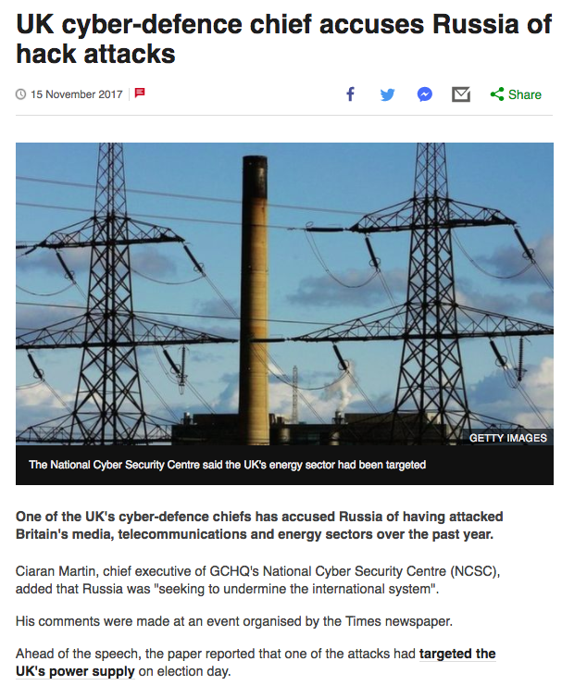
International cyber threats continue to rise
https://www.insurancejournal.com/news/international/2019/07/24/533763.htm
https://www.infosecurity-magazine.com/news/most-uk-it-security-leaders-fear-1/

Slide 5
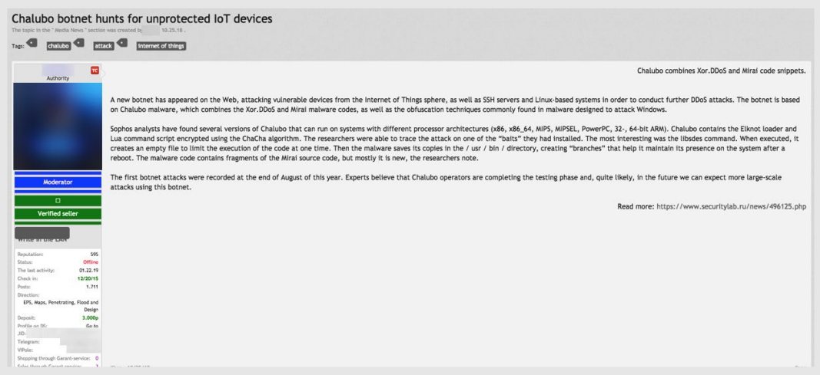
… as they are becoming simpler
IoT botnet targeting DDoS attacks
User requesting for exploitable vulnerabilities in IoT devices
Source https://documents.trendmicro.com/assets/white_papers/wp-the-internet-of-things-in-the-cybercrime-underground.pdf

Slide 6
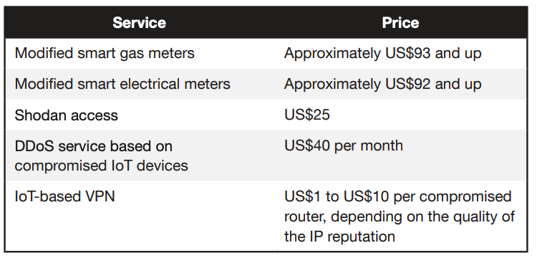
…and cheaper
Prices of the services identified in Russian underground forums
Source https://documents.trendmicro.com/assets/white_papers/wp-the-internet-of-things-in-the-cybercrime-underground.pdf

Slide 7
The need for security has never been higher
*
$500B+ per year
Intellectual property theft
Counterfeiting
Cloning and over-production
Combined GDP of Ireland & Netherlands
Electronic devices Rank #4 & #6 by volume; #1 by value
Overproduction & Counterfeiting Rampant
Offshoring has led to massive rise in issues
Transition of value moving to IP & Software
* : OECD, April 2016. Trade in Counterfeit &Pirated Goods Mapping The Economic Impact
**: OECD, April 2015. http://dx.doi.org/10.1787/888933345913

Slide 8
Product supply chains are complex & weak
All the news is about attacks here i.e.
IoT devices in service
But attacks can also occur here …
… and here
enterprise iot insights, 2017

Slide 9
IoT Supply Chain are even more complex
Many players, multiple attack opportunities
End User
Silicon
Platform
Vendor
Provisioning
Centre
Contract
Manufacturer
Programming
Centre
Software
Application
Developer
IoT
Device
OEM

Slide 10
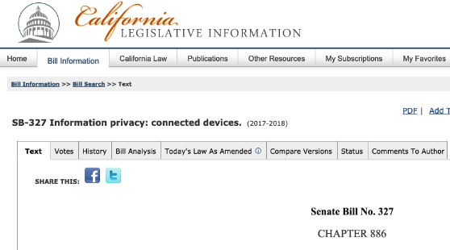
Current Security Legislation
Europe
UK (DCMS) – Adopted IoT Security Foundation Best Practice
ETSI – Adopted UK DCMS guidelines
EU (ENISA) – >150 baseline recommendations
North America
California – Senate Bill 327
USA - NIST evolving cybersecurity act
Asia
Singapore – Adopted DCMS guidelines
Japan – Ministry of Internal Affairs defines IoT device law
Korea – The Ministry of Science and ICT & Internet & Security Agency
China –Standards released by government-sponsored working group

Slide 11
Legislative Evolution
DCMS undergoing consultation for Consumer Devices*
Over 6,500 consumers and groups
49% of consumers consider security features important in decision making
72% believe (wrongly) that security features already built into device
59% of participants willing to pay a premium for security
Service revenues rely on secure end points
Practical solutions sought by government for actual law
No default passwords………………………………………. Formal cryptographic identity requirements
Vulnerability disclosure & point of contact ……… Organizations have a legal responsibility for products
Explicit minimum time supporting updates……… Legal contract of support with users
* Source: https://isoc-e.org/wordpress/wp-content/uploads/2019/05/DCMS-Consultation-Internet-Society-presentation.pdf

Slide 12
California Senate Bill 327
All connected devices SOLD in the state MUST incorporate "reasonable security feature or features"
Protection against unauthorized access, modification, or disclosure of data
Device authentication is the minimal bar
Identity
Attestation
Immutable Root of Trust
Single hard-coded passwords are not allowed
Each device must either have a unique passcode
Or user must generate a new passcode before using the device for the first time.
Implementation Date
1st January 2020

Slide 13
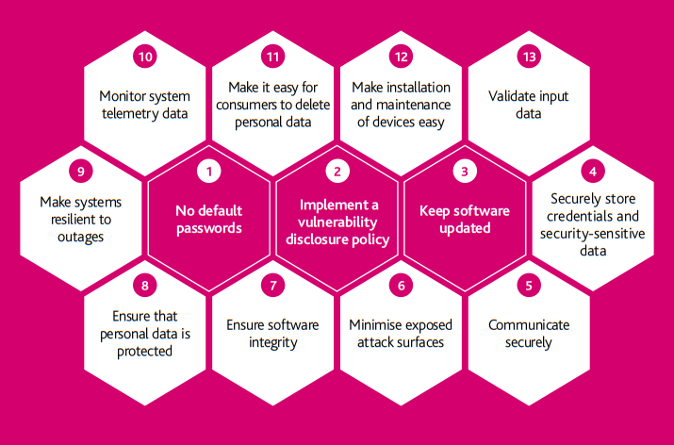
IoT Code of Practice – Consumer Devices

Slide 14
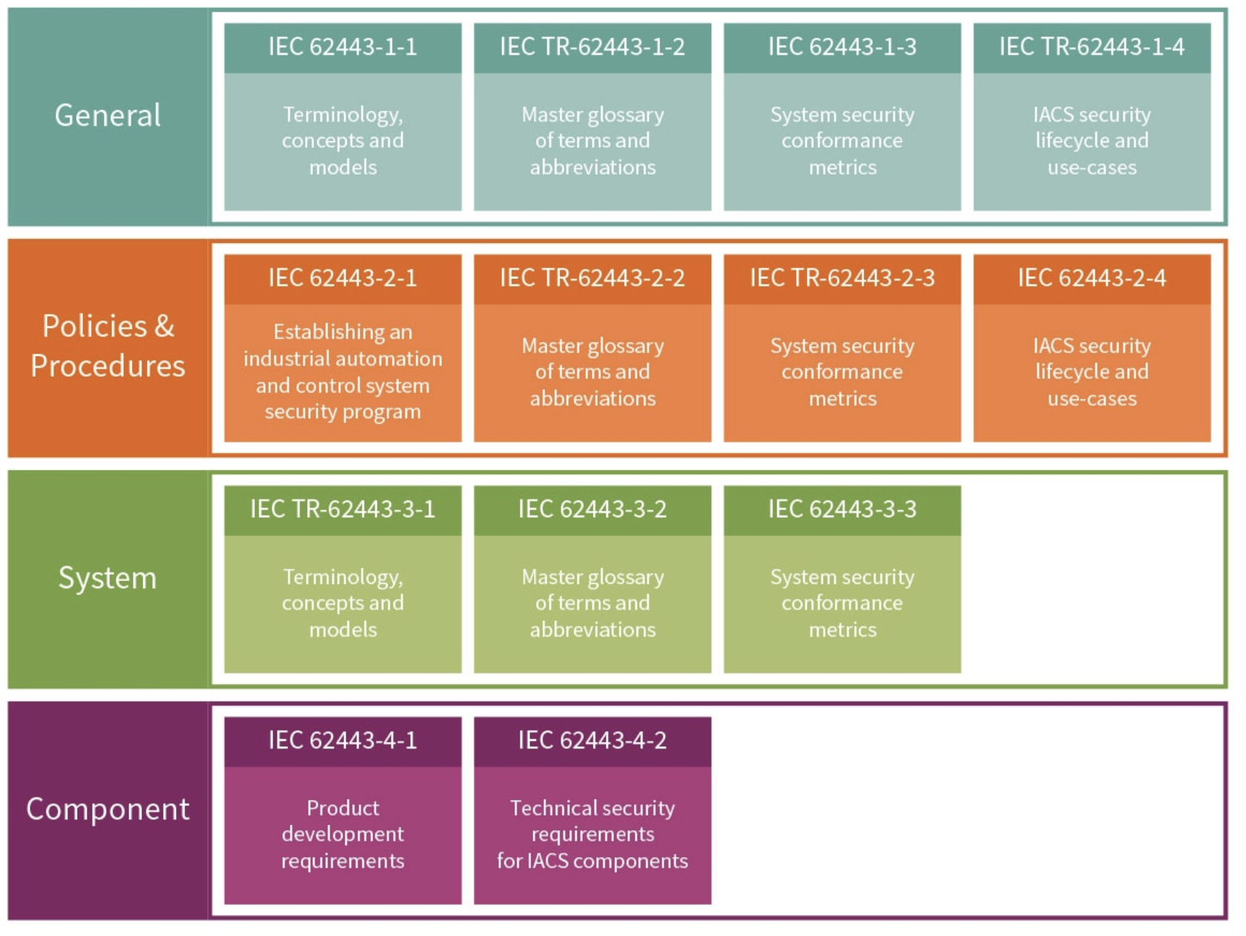
Industrial IoT is reacting to evolving standards – IEC 62443
Security Level (SL) | IEC 62443-1-1 section 10.4.3 Protection Profile
0 | No specific requirement
1 | Casual or coincidental violation
2 | Intentional violation using simple means and low resources
3 | Intentional violation using sophisticated means with moderate resources
4 | Intentional violation using sophisticated means with extended resources → Nation State Sponsored
Device Specific Implementation

Slide 15
How we can build secure IoT devices to meet the new legislative challenges January 2020
Haydn Povey – CEO & Founder
haydn.povey@securethingz.com
Founding Member
Third Annual Cyber Conference
Cyber Innovation Hub of Canterbury Christ Church University

Slide 16
1 Million
unfilled cybersecurity jobs in 2014
https://cybersecurityventures.com/jobs/
3.5 Million est.
unfilled cybersecurity jobs by 2021
Major scalability issues within slow-adoption industries
Stop re-inventing the wheel
Transition to scalable solutions

Slide 17
Leveraging PSA for Secure Devices
Platform Security Architecture
Provides a list of guidelines for secure device implementation
Hardware (block level)and software guidance
Systematically justify security requirements against identified attacks & threat models
Certification methodology (PSA-1 & PSA-2)

Slide 18
Simplified PSA-compatible device architecture
Normal world code
Trusted software
Apps/user
Trusted
libs
Unprivileged
Crypto
Comms stack
Attestation
RTOS scheduler
Secure Partitioning Manager
Privileged
Platform code
Device drivers
Hardware Interfaces
ARMv8M / Cortex-M
or other architecture
Microcontroller
TRNG
Crypto Accelerators
Initial RoT & security subsystem
Unique ID
Secure storage
Physical IP

Slide 19
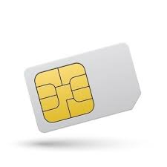
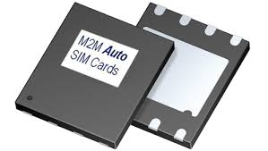
Why SoC-based Security?
Cheaper
More Flexible
More Functional
Real-estate costs
Material costs
Handling costs
Not limited to old ISO7816 low-bandwidth protocols
Not limited to only Java Applets
Not limited to a single-thread OS
Support of mobile payment, mobile network authentication, company security, … with one security subsystem

Slide 20
Chip based security solutions are evolving
Good Better Best
Encrypted software installation
Signed updates
Code isolation (TZ-M, etc)
Secure Key generation (PUF)
Immutable identity
TrustZone-M
SE Authenticated Updates
Modular Secure Update.
Secure Key provisioning into MCU.
Authenticating to the Secure MCU.
Demand
Initial IP Protection
Secured Updates
Remote attack protection
Robust device authentication.
Ensures keys are protected against physical attack
Ensuring best in class security
Best & modular secure updates.
Full integrated single chip solution.
Benefit
Isolated On-chip Memory
MPU
Debug control
Separate or integrated
Secure Element
TrustZone-M
Secure Enclave
Secured Flash Memory
Secure OTP Memory
Hardware

Slide 21
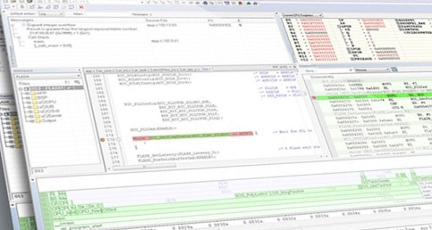
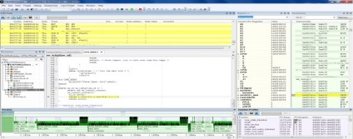
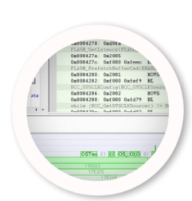
Legacy software development flows also need to evolve
Develop application
Test
Release
Manage
Manufacture
Design and develop the application code
Build and debug the application
Release image to manufacturing
11111001001010101010101001010011001010101010101010101000101011111001010111010111100101010101010010010100001111010011110101001000101111010011110011110101
0010111100
010101111011101010101010010101110101010100000110101010101010101010101001010101010100101111110000011010111101001111010100100010111101001111011011
00101111010010010111100101110011100
11010100101010111100100111001010000010010010110000101000101000101001011
001011110100111101
001011110000001110101100001010101111
Review issues using static code analysis
Find and investigate runtime errors
Notes:
In your traditional software development workflow, the requirements are elicited, then the application is developed, debugged, then released. At this point, it goes in a maintenance mode where bugs are identified and bug fixes released. You need to have a high degree of trust in your contract manufacturer that the night shift won’t make a huge production run of grey-market goods for which you never see the revenue.

Slide 22
Security Centric Development Flow
Notes:
In a secure workflow, many aspects are the same for the software developer, but the board first undergoes provisioning: the Embedded Trust user develops a security context, configures and builds a Secure Boot Manager, then uses these two things to provision individual boards with unique keys and certificates as well as the SBM. This is all locked away in the secure area of flash at provision-time. For the firmware developer, they only have to make a couple of small changes to their project once per project: they need to enable security with the context given to them by the Embedded Trust user, and they need to adjust the start address and vector table of their application to match where the SBM expects it to be when the device boots up. When you are ready for production, the Embedded Trust user creates a production export for delivery to your contract manufacturer which only allows them to provision a certain number of devices.

Slide 23
Organizational Based Security Contexts
Widespread acceptance in the industry that for IoT devices to be secure, each and every device needs a truly unique identity
Transition from simple ID and passwords to x.509 PKI solutions – even for simplest of devices
Secure immutable boot process leveraging SoC hardware security features
Integrity & authentications checks on the system firmware, RTOS and apps
Prevent fraudulent software from execution
Protect confidentiality of the firmware
Offers applications an interface to a secure key storage in the hardware
Manage updates from reset
Encryption & Decryption of all update material
Authentication and anti-rollback protection

Slide 24
A Workflow for Safeguarding the IoT Supply Chain
Security Context
Application RoT
Create organizational Security Context
Define the application Root of Trust
Inherit Secure Context
Develop Application
Test
Lifecycle aware development
Development Keys ONLY
Encrypt, sign and deploy to targeting production
Build using HSM generated Production Keys
Deploy
Manage
Manufacture

Slide 25
1. Specify and Design Security Context
Security Context
Application RoT
Create organizational Security Context
Define the application Root of Trust
0010111101001111010100100010111101001111110101101010100011110101011010101101101101010100101001001001011010100101001000111010001001011
00101111010000011110010110100101010101
100101001110111100
Configure security options and policies
Build the Secure Boot Manger code image
Create device key pairs - used for authentication
Create device certificate templates & certificate chains
Create software signing keys - used for field updates
Provision (securely program) the device
0101101001011
001011101101010010001010100101110010111101111101001111001010101001101011000010111100

Slide 26
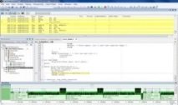
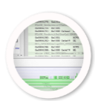
2. Develop and Test
Develop using a standard IDE workflow
Development keys & certificates used
The application is mastered and encrypted
The secure application image is processed by the Secure Boot Manager
Inherit Secure Context
Develop Application
Test
Lifecycle aware development
Development Keys ONLY

Slide 27
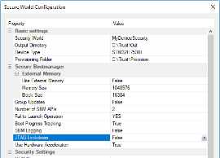
3. Deploy and Manufacture
Encrypt, sign and deploy to targeting production
Build using HSM generated Production Keys
Deploy
Manage
Manufacture
Production export
Production keys & certificates used
OEM Security Context
Keys, certificates & product templates
OEM Secure Content securely wrapped and transferred to Hardware Security Module (HSM)
Secure Boot Manager & application
Programming scripts
00101111010011110101001000101111010011110101001011
00101111010011110101
0010111100
SBM
0101001011
00101111010011110101
0010111100
Manufacture
00101111010011110101001000101111010011110101001011
00101111010011110101
0010111100
Mastered Application

Slide 28
SOLUTIONS

Slide 29
Device Identity Proof
Remote Services can verify the device identity based on a device certificate containing the public key
A random challenge from an external Attestation Service triggers a corresponding response from the Secure Boot Manager
Random challenge is signed with the device’s private key and externally verified
Random challenge
Application & Services
Public
OS Kernel
Attestation Service
Signed random challenge
Secure Boot Manager with Root-of-Trust
Private
Sign
HW Security Layer (e.g. Arm TrustZone)
System-on-Chip (SoC)

Slide 30
Device Integrity Proof
Remote Services can verify the device integrity based on a device certificate containing the public key
A hash value of code/data is calculated by the Secure Boot Manager and sent to an external Integrity Verification Service owing the corresponding public key
Application & Services
Public
Hash value of code / data
OS Kernel
Integrity Verification Service
Signed random Hash value of the relevant code / data in the OS/Apps
Secure Boot Manager with Root-of-Trust
Private
Sign
HW Security Layer (e.g. Arm TrustZone)
System-on-Chip (SoC)

Slide 31
TLS Client/Cloud Authentication
A remote server request the device to authenticate in a TLS session
The required signature operation for this mutual authentication in a handshake is calculated by the Secure Boot Manager
Application & Services
Public
Service
with
TLS Stack
OS Kernel
TSL Server/ Cloud requesting a client authentication
TLS Handshake
Secure Boot Manager with Root-of-Trust
Private
Sign
HW Security Layer (e.g. Arm TrustZone)
System-on-Chip (SoC)

Slide 32
Device Management
A remote server opens a secure channel in a mutual authenticated TLS session
This secure channel can be now used to change the configuration of the device and update/modify parts of the firmware/RTOS/apps/services
TLS Tunnel
Application & Services
Change of device configuration
Public
Service
with
TLS Stack
OS Kernel
Device Management Server
Device configuration change in a TLS Tunnel
Secure Boot Manager with Root-of-Trust
Private
Sign
HW Security Layer (e.g. Arm TrustZone)
System-on-Chip (SoC)

Slide 33
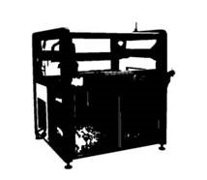
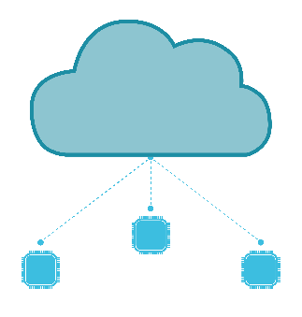
Industry Alignment For A Secure Future
Enablement
Secure Silicon
Empowerment
Secure Development
Implement
Secure Provisioning
Lifecycle Management
Secure Update
Secure Cloud

Slide 34
Securing the IoT supply chain with Integrated SoC Security
Conclusion
There are multiple drivers:
Evolving legislation
Theft of Intellectual Property
Hacking
Injection of malware
Counterfeiting
Cloning
Securing your IP must be a priority for all organizations involved in the creation of IoT devices
Best practices call for ”Security from Inception” approach delivered through a Supply Chain of Trust

