Slide 1
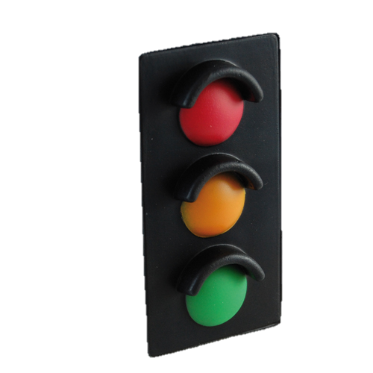

The Traffic Lights Toolkit
Introduction:
Using the Traffic Lights Toolkit with large cohorts
©Canterbury Christ Church University 2018
A Catalyst Fund project supported by the HEFCE Higher Education Innovation Fund (HEIF)

Slide 2
What is the Traffic Lights Toolkit?
The Traffic Lights Toolkit is a set of pedagogic tools developed by an interdisciplinary team at Canterbury Christ Church University for students in higher education.
These tools are flexible and can be adapted to a range of learning situations and student cohorts.
©Canterbury Christ Church University 2018

Slide 3

The Traffic Lights Toolkit helps identify barriers and enablers to learning
Looking inside the student ‘Black Box’:
Prior Learning
(West and Fensham, 1974;
Gijlers and de Jong, 2005)
Learning disabilities (Fuller et al., 2004;
Denhart, 2008)
Background,
Experiences
(Niles, 1995;
Schuetze and Slowey, 2002)
Emotions
(Caplin, 1969;
Roundtree and Roundtree 2009)
©Canterbury Christ Church University 2018
Notes:
This slide examines the barriers to learning that students might experience. The ‘black box’ illustrates the lack of information educators often have when first meeting a student or student cohort. Students themselves may be unaware of the barriers to learning that exist for them as well as the enablers that would allow them to learn more effectively. The Traffic Lights Toolkit (TLT) allows students to identify and articulate these barriers via self-assessment and develop ways of addressing these. Teachers can adjust and change their teaching and support strategies in response to the student’s responses to the TLT. For example, where students express a significant amount of negative emotions in response to a learning objective/skill or competency they have self-assessed themselves against, a teacher can approach their teaching with this in mind, for example by discussing emotional resistance to learning and providing strategies for students to overcome this barrier.

Slide 4
The Traffic Lights Toolkit helps break down barriers to learning
Some skills and subjects are prone to creating barriers for students:
Placements and dissertations
Unstructured/problem-based learning
‘Troublesome Knowledge’ (Meyer and Land, 2003)
‘Threshold Concepts’ (e.g. Sheja and Pettersson, 2010)
©Canterbury Christ Church University 2018
Notes:
Depending on your area of teaching, you may be aware of other/similar areas of learning where students experience high levels of anxiety, confusion and other learning barriers.

Slide 5
How does the Traffic Lights Toolkit work?
The toolkit includes three tools that allow students to self-assess themselves against expected learning outcomes that are phrased as skills statements (“I can…”).
Students initially express their comfort level in relation to each statement with one of the three traffic light colours.
©Canterbury Christ Church University 2018
Notes:
This slide examines the barriers to learning that students might experience. The ‘black box’ illustrates the lack of information educators often have when first meeting a student or student cohort. Students themselves may be unaware of the barriers to learning the experience. The Traffic Lights Toolkit (TLT) allows students to identify and articulate these barriers via self-assessment and develop ways of addressing these. Teachers can adjust and change their teaching and support strategies in response to the student’s responses to the TLT. For example, where students express a significant amount of negative emotions in response to a learning objective/skill or competency they have self-assessed themselves against, a teacher can approach their teaching with this in mind, for example by discussing emotional resistance to learning and providing strategies for students to overcome this barrier.

Slide 6
Challenge Zone
Stress Zone
Comfort Zone
©Canterbury Christ Church University 2018

Slide 7
Comfort
Easy going
Of course I can/will
Challenge
Negotiable, with support
Willing to try, willing to make mistakes if that is ‘safe’
Stress
No way
I will defend my position
No problem
Don’t yet feel confident or competent but believe we can get there – somewhere we know we can
I will not do this; I will not discuss this; I will not disclose this
Tendency to blame
©Canterbury Christ Church University 2018

Slide 8

Benefits for learners
It develops skills of reflection, self-regulation and self-assessment.
It supports academic and personal development - engagement with the tool acknowledges prior learning and skills, identifies opportunities for development and areas of potential challenge or perceived threat/risk.
It encourages students to take increasing responsibility for their learning by engaging both the cognitive and affective dimensions.
©Canterbury Christ Church University 2018
Notes:
This slide should introduce the

Slide 9

Benefits for learners
“Looking back on it I feel good that I can now do things I couldn’t before and identify any areas that I still need work on.”
“TLT helped me track my progress.”
“Discovering what I was/wasn't confident with helped me more than I realized.”
“It helped me to understand where I needed to gain knowledge and prompted me to ask for help in those areas.”
“It does encourage you to interact with your supervisor.”
©Canterbury Christ Church University 2018
Notes:
This slide should introduce the

Slide 10

Benefits for teachers
It Establishes a proactive approach to student engagement with learning objectives, to enhance and promote resilience rather than waiting for difficulties to be encountered.
It promotes proactive academic strategies.
©Canterbury Christ Church University 2018
Notes:
This slide should introduce the

Slide 11

Components of the Traffic Lights Toolkit
There are three components to the Traffic Lights Toolkit (TLT)
The Perception of Challenge Tool (PoC)
The Quadrant Tool (Q)
The Rating Scale Tool (RS)
©Canterbury Christ Church University 2018

Slide 12

The Perception of Challenge Tool
Comfort
Challenge
Stress
©Canterbury Christ Church University 2018
Notes:
This portion of the presentation explains the three tools within the Traffic Lights Toolkit, how they build upon each other and how students can work with them. At this point it should be pointed out that the tools can be delivered on paper as well as digitally, using the templates and resources available at www.canterbury.ac.uk/TLT. This presentation can be adapted accordingly, depending on which delivery method(s) are used..

Slide 13
Working with the Traffic Lights Toolkit
Students can be asked to engage with the tool individually (e.g. to prepare for a tutorial) or as a group (e.g. as part of a module or course induction).
The toolkit is most effective when students engage with it repeatedly to track their learning progress. Engagements with the tool are most effective when combined with a correspondingly timed tutorial or element of assessment.
©Canterbury Christ Church University 2018

Slide 14
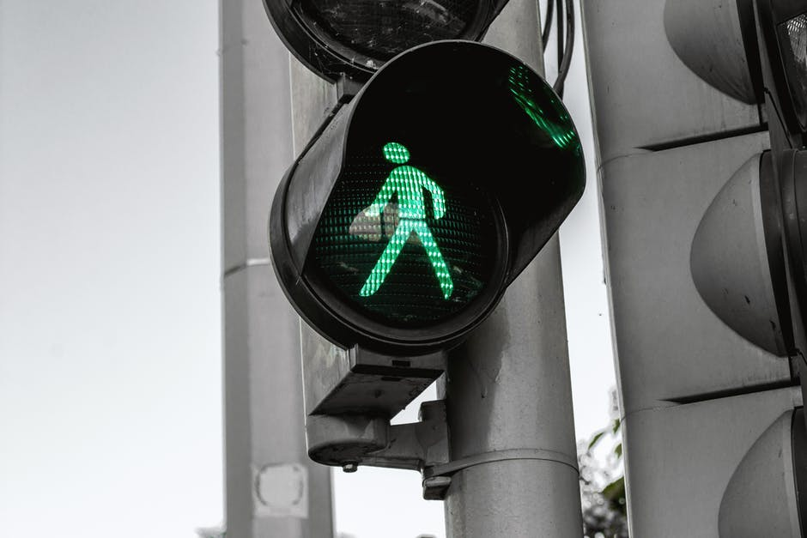
Working with the Traffic Lights Toolkit
Always ask students to begin with identifying those elements they perceive as ‘green’. This step is crucial in establishing feelings of confidence and competence at the outset.
©Canterbury Christ Church University 2018

Slide 15
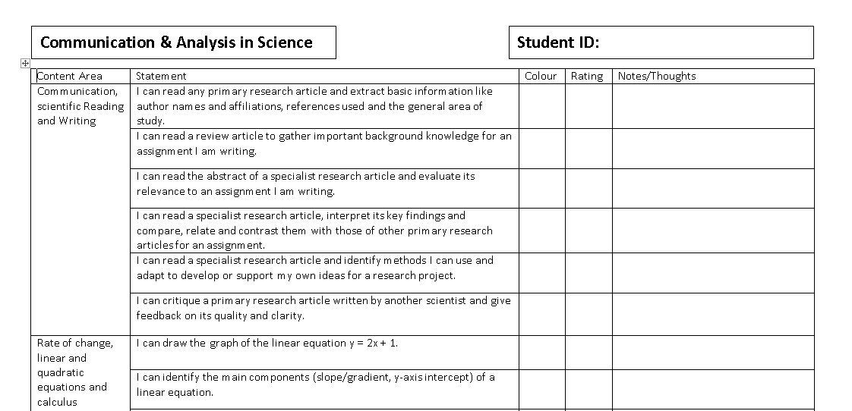
Examples of skills/competency
statements.
©Canterbury Christ Church University 2018
Notes:
This is an example of a Perception of Challenge Tool sheet. For details on how to compose and create a sheet like this and the statements within it, please refer to the resources available at www.canterbury.ac.uk/TLT.

Slide 16
Student has indicated their confidence level against each skill statement (green/amber/red) and has included a numerical confidence rating (1-10, least to most confident).
The student has also added some comments providing reasons for their assessment
©Canterbury Christ Church University 2018

Slide 17
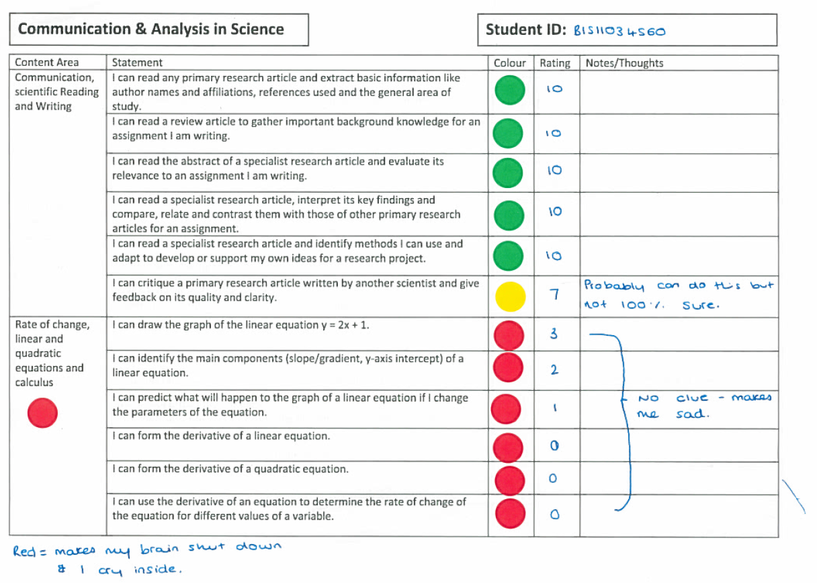
Note the emotional language this student has used to indicate an emotional barrier to learning.
©Canterbury Christ Church University 2018

Slide 18
The Quadrant Tool
Comfort
Challenge
Stress
©Canterbury Christ Church University 2018
Notes:
This portion of the presentation explains the three tools within the Traffic Lights Toolkit, how they build upon each other and how students can work with them. At this point it should be pointed out that the tools can be delivered on paper as well as digitally, using the templates and resources available at www.canterbury.ac.uk/TLT. This presentation can be adapted accordingly, depending on which delivery method(s) are used..

Slide 19
This Tool is based on the Quadrant model
(Pratt, 1988)
Support refers to “the affective encouragement the learner needs from others. It is also the product of two factors: the learner’s commitment to the learning process and the learner’s confidence about his or her learning ability.”
Low Need for Support High
1
2
3
4
Low Need for Direction High
Direction, “refers to the learners need for assistance from other persons in the learning process, and is a function of an adult’s competence in the subject matter and general need for dependence.”
©Canterbury Christ Church University 2018
Notes:
The second tool in the toolkit, the Quadrant tool, is based on Pratt’s (1988) model for the need for direction and support. The tool allows students to identify their needs by placing each statement assessed in the Perception of Challenge Tool in the two-dimensional space of the Quadrant Tool. Direction, “refers to the learners need for assistance from other persons in the learning process, and is a function of an adult’s competence in the subject matter and general need for dependence.” Support refers to “the affective encouragement the learner needs from others. It is also the product of two factors: the learner’s commitment to the learning process and the learner’s confidence about his or her learning ability.” Knowles et al (2005:195) Pratt’s representation of these dimensions as a four quadrant model provides a very clear means by which one can approach the diverse and changing needs of a group of adult learners.

Slide 20
Week One
Low Support High
1
13
16
8 15
12 3
14
Students place each numbered statement form the Perception of Challenge Tool in the two dimensional space of the Quadrant Tool, according their need of support and direction with each statement.
1
2 6 7
5 17
11
Low Direction High
©Canterbury Christ Church University 2018
Notes:
This slide and the following slides provide an example of how a student used the Quadrant Tool for a placement module in the School of Allied Health Studies at Canterbury Christ Church University with Marian MacCormick who developed the original Toolkit.

Slide 21
Week Three
Low Support High
9
13
16
13
8 15
12 3 14
With each engagement with the tool, the need for support and direction decreases and the statements move accordingly within the Quadrant tool as recorded by the student.
8
1 3
2 6 7
5 17
11
Low Direction High
©Canterbury Christ Church University 2018

Slide 22
Week Three
The Quadrant Tool visualizes the increase in confidence and competency.
Low Support High
9
Confidence
Autonomy
Initiative
Independence
Low Direction High
©Canterbury Christ Church University 2018

Slide 23
The Rating Scale Tool
Comfort
Challenge
Stress
©Canterbury Christ Church University 2018
Notes:
This portion of the presentation explains the three tools within the Traffic Lights Toolkit, how they build upon each other and how students can work with them. At this point it should be pointed out that the tools can be delivered on paper as well as digitally, using the templates and resources available at www.canterbury.ac.uk/TLT. This presentation can be adapted accordingly, depending on which delivery method(s) are used..

Slide 24
The Rating Scales Tool
0
10
Move from:
What I am doing now:
Move towards:
What I will be doing:
The Rating Scale Tool is used for one or more of the statements included in the Perception of Challenge Tool, usually those the student is most concerned about. Students indicate their confidence rating on a scale from 1 to 10 (lowest to highest).
©Canterbury Christ Church University 2018

Slide 25
The Rating Scales Tool
0
10
3
5
Move from:
What I am doing now:
How will you know that you have moved up from 3 to 5?"
Asking this question invites an answer from the student in terms of criteria, in terms of signs that are meaningful to them:
"I will know that I have moved up a point on the scale because I will notice myself beginning to .. feel more confident,
I will be (doing) …
"What will others notice about how I am doing things differently?
Move towards:
What I will be doing:
Students can then use spaces provided below the rating scale to articulate their current level of competency (red box) as well as the level of competency they are aiming for (green box) as well as indicator that they have achieved this level of competency (black box).
©Canterbury Christ Church University 2018

Slide 26
The Traffic Lights Toolkit and large cohorts: learning from students
Student responses to the Tools can be visualized, analysed and otherwise interpreted by teachers to gain insight into the ‘black box’ of student barriers to learning.
The following slides contain examples of this for a cohort of approx. 50 students engaging with the Perception of Challenge Tool in a second year module in the Life Sciences at Canterbury Christ Church University dealing with mathematics, statistics and other ‘troublesome knowledge’.
©Canterbury Christ Church University 2018

Slide 27

‘Confidence Maps’: Visualizing student confidence
When collating student responses digitally, the colours each student has indicated for each statement can be combined into a ‘heat map’ of where students are particularly high or low in confidence. Teaching and support provision can be adjusted in response.
Challenge Zone
Stress Zone
Comfort Zone
©Canterbury Christ Church University 2018

Slide 28
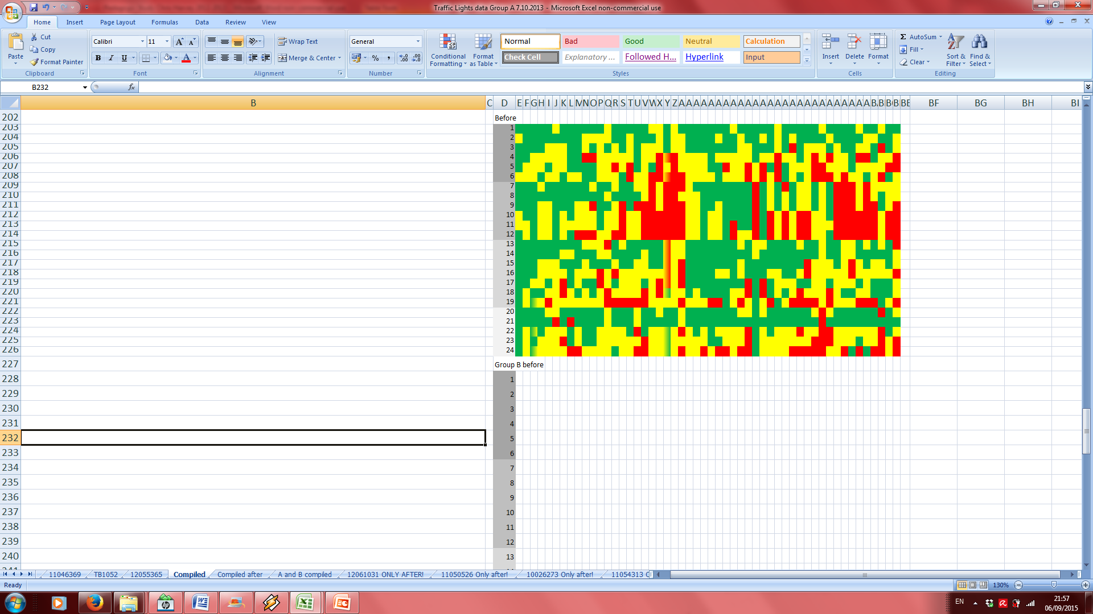
‘Confidence Maps’: Beginning of module
Each column represents one student, each line one skill statement
Skill/competency area:
Scientific
Reading
/Writing
Maths
Statistics
Research
Methods
©Canterbury Christ Church University 2018

Slide 29
‘Confidence Maps’: Beginning of module
Scientific
Reading
/Writing
Maths
Statistics
Research
Methods
©Canterbury Christ Church University 2018
Areas of predominant red and green indicate areas of low and high confidence, respectively.

Slide 30
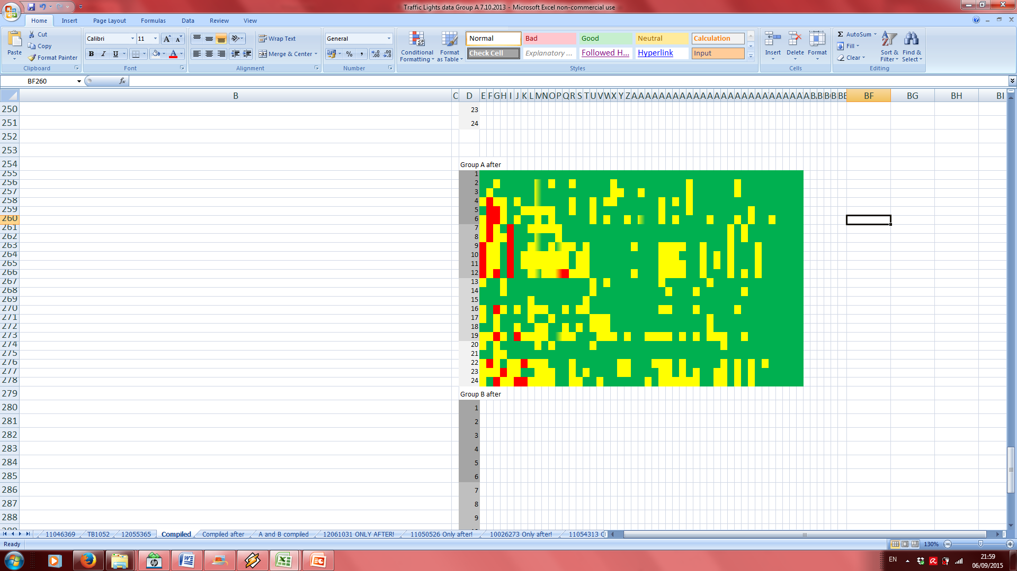
‘Confidence Maps’: End of module
Scientific
Reading
/Writing
Maths
Statistics
Research
Methods
©Canterbury Christ Church University 2018
Colour change from red/amber to green indicates increase in confidence and feeling of competency.

Slide 31
Graphing Confidence: Beginning of module
Skills and competencies with a high proportion of ‘red’ responses indicate a high incidence of barriers to learning.
©Canterbury Christ Church University 2018

Slide 32
How students describe barriers to learning:
“I tend to over complicate a method and make it more difficult for myself.”
“…under the pressure of presenting the work in front of my peers I am not entirely sure how effective the results and research I have done will come across.”
“Having changed the type of replication we are doing within the study I have to do an analyses I haven't used before.”
“I can use equipment that I am familiar with, however I don’t have the confidence to do it on my own.”
“I felt confident before the investigation that I could see potential problems, however we encountered problems in the investigation that I hadn’t anticipated.“
©Canterbury Christ Church University 2018

Slide 33
How students describe enablers to learning:
“In this session, there was more time to discuss as a group what may go wrong when we actually go to undertake the experiment.”
“I have been doing this through my degree and have much experience on searching for relevant literature and referencing.”
“Once I have carried out the procedure at least one time with supervision I am confident to do it on my own.”
“I am great at organizing and managing my time effectively.”
“I struggle with statistical analysis, so will go through my notes and consult tutors to discuss whether or not the test I am using is being done correctly.”
“I came up with a control for my experiment successfully with my team and feel more confident in performing this skill.”
©Canterbury Christ Church University 2018

Slide 34
Sharing outcomes with learners
A benefit arising from collecting, collating and analysing data is that the outcomes for a whole groups/cohort can be shared with that same group to illustrate the shared experience of learning and emphasize the learning that has been achieved over the course of using the tool.
Sharing outcomes with future cohorts of students can illustrate to them successful strategies for gaining confidence and the learning journey taken by students preceding them.
©Canterbury Christ Church University 2018

Slide 35

The Traffic Lights Toolkit: Do’s
The Traffic Lights Toolkit works best when it is integrated with other learning activities to encourage regular engagement, for example tutorials, group discussions or formative and summative assessments.
Remind students to engage
with the tool.
If students are unfamiliar with reflection,
explain the concept and illustrate its
importance in higher education.
©Canterbury Christ Church University 2018

Slide 36
The Traffic Lights Toolkit: Do’s
Ensure all staff involved are fully briefed on the use and purpose of the tool to provide consistent support and information on the tool.
Explain to students the utility of the tool in developing skills of reflection and autonomy in self-assessment. Gains in confidence do not automatically translate into improved achievement/ competency if reflection and learning are not genuine.
©Canterbury Christ Church University 2018

Slide 37

The Traffic Lights Toolkit: Don’ts
Don’t overload the Tools by including too many statements or only high-level statements that require considerable skill/competency. This can overwhelm students and increase anxiety.
Don’t assess the content of Tools completed by students.
©Canterbury Christ Church University 2018

Slide 38
Alcorn Jr, M. W. (2013) Resistance to Learning: Overcoming the Desire-Not-To-Know in
Classroom Teaching. 1st edn. London: Palgrave Macmillan.
Ashcraft, M.H. (2002) ‘Math anxiety: personal, educational, and cognitive consequences’ Current Directions in Psychological Science, 11 (5), pp.181–185.
Barradell, S. (2013) ‘The identification of threshold concepts: a review of theoretical complexities and methodological challenges’ Higher Education, 65(2), pp.265–276.
Bloom, B. S. (ed.) (1956) Taxonomy of Educational Objectives, the classification of educational goals
– Handbook I: Cognitive Domain. New York: McKay
Booth, J. (2006) ‘On the mastery of philosophical concepts’, in: Meyer, J. & Land, R. (eds.)
Overcoming barriers to student understanding: Threshold concepts and troublesome
knowledge. 1st edn. New York: Routledge, p. 173.
Brockbank, A. & McGill, I. (2007) Facilitating reflective learning in higher education. 2nd edn. London:
McGraw-Hill Education.
Busato, V. V., Prins, F. J., Elshout, J. J. & Hamaker, C. (2000) ‘Intellectual ability, learning style, personality, achievement motivation and academic success of psychology students in higher education’ Personality and Individual Differences, 29(6), pp.1057–1068.
Caplin, M.D. (1969) ‘Resistance to learning’ Peabody Journal of Education, 47(1), pp.36–39.
Csikszentmihalyi, M. & Wong, M., (2014) ‘Motivation and academic achievement: the effects of personality traits and the quality of experience’, in: Csikszentmihalyi, M. (ed.) Applications of Flow in Human Development and Education. 2nd ed. Dordrecht, Netherlands: Springer, pp. 437–465.
Duit, R. & Treagust, D.F. (2003) ‘Conceptual change: a powerful framework for improving science teaching and learning’ International Journal of Science Education, 25(6), pp.671–688.
Dweck, C. S. (2000) Self-theories: Their role in motivation, personality, and development. 1st edn.
New York: Psychology Press.
Eilks, I. (2014) ‘Action research in science education: from general justifications to a specific model in
practice’, in: Stern, T., Townsend, A., Rauch, F. & Schuster, A. (eds.) Action research,
innovation and change: international perspectives across disciplines. London: Routledge, pp.
156-176.
Feldman, A. & Minstrell. J. (2000) ‘Action research as a research methodology for the study of the
teaching and learning of science’, in: Kelly, A. E. & Lesh, R. A. (eds.) Handbook of research
design in mathematics and science education. 1st edn. London: Routledge, pp. 429-455.
Gijlers, H. & de Jong, T. (2005) ‘The relation between prior knowledge and students’ collaborative discovery learning processes.’ Journal of Research in Science Teaching, 42(3), pp.264–282.
Grow, G.O. (1991) ‘Teaching learners to be self-directed’. Adult Education Quarterly , 41 (3), pp.125–149.
Hay, D., Kinchin, I. & Lygo‐Baker, S. (2008) ‘Making learning visible: the role of concept mapping in higher education’ Studies in Higher Education, 33(3), pp.295–311.
Hayes, K. & Richardson, J.E. (1995) ‘Gender, subject and context as determinants of approaches to studying in higher education’ Studies in Higher Education, 20(2), pp.215–221.
Hembree, R. (1990) ‘The nature, effects, and relief of mathematics anxiety’ Journal for Research in Mathematics Education, 21(1), pp.33–46.
Jones, R. & Thomas, L. (2005) ‘The 2003 UK government higher education white paper: a critical assessment of its implications for the access and widening participation agenda’ Journal of Education Policy, 20(5), pp.615–630.
Kolb, A. Y., & Kolb, D. A. (2005) 'Learning styles and learning spaces: enhancing experiential learning in higher education', Academy of Management Learning & Education, 4(2), pp. 193–212.
Kozeracki, C.A., Carey, M. F., Colicelli, J. & Levis-Fitzgerals, M. (2006) ‘An intensive primary-literature–based teaching program directly benefits undergraduate science majors and facilitates their transition to doctoral programs’ CBE-Life Sciences Education, 5 (4), pp.340–347.
Krathwohl, D.R. (2002) ‘A revision of bloom’s taxonomy: an overview’ Theory Into Practice, 41(4), pp.212–218.
Land, R., Cousin, G., Meyer, J. H. F. & Davies, P (2006) ‘Conclusion: implications for threshold
concepts for course design and evaluation’, in: Meyer, J. & Land, R. (eds.) Overcoming barriers
to student understanding: Threshold concepts and troublesome knowledge. 1st edn. New York:
Routledge. pp. 195-206.
LeBard, R., Thompson, R., Micolich, A., Quinnell, R. (2012) "Identifying common thresholds in
learning for students working in the'hard'discipline of Science." Proceedings of The Australian
Conference on Science and Mathematics Education (formerly UniServe Science Conference).
Sydney, 1 - 2 October 2009
Light, G., Calkins, S. Cox, R. (2009) Learning and teaching in higher education: The reflective
professional. 1st edn. London: Sage
Loo, R. (2002) ‘The Distribution of learning styles and types for hard and soft business majors’
Educational Psychology, 22(3), pp.349–360.
Lynch, T.G., Woelfl, L.L., Steele, D. J. & Hanssen, C.S. (1998) ‘Learning style influences student examination performance’ The American Journal of Surgery, 176(1), pp.62–66.
Ma, X. (1999) ‘A meta-analysis of the relationship between anxiety toward mathematics and achievement in mathematics’ Journal for Research in Mathematics Education, 30(5), pp.520–540.
Macdonald, C. & Stratta, E. (2001) ‘From access to widening participation: responses to the changing population in higher education in the UK’ Journal of Further and Higher Education, 25(2), pp.249–258.
Meyer, H. (2004) ‘Novice and expert teachers’ conceptions of learners' prior knowledge’ Science Education, 88(6), pp.970–983.
Meyer, J. H. F. & Land, R. (2003) ‘Threshold Concepts and Troublesome Knowledge 1 – Linkages to
Ways of Thinking and Practising’, in: Rust, C. (ed.) Improving Student Learning – Ten Years On.
1st edn. Oxford: OCSLD.
Meyer, J. & Land, R. (2006) Overcoming barriers to student understanding: Threshold concepts and
troublesome knowledge. 1st edn. New York: Routledge.
Mikkonen, J., Ruohoniemi, M. & Lindblom-Ylänne, S. (2011) ‘The role of individual interest and future goals during the first years of university studies’ Studies in Higher Education, 38(1), pp.71–86.
Morrison, K. (1996) ‘Developing reflective practice in higher degree students through a learning journal’ Studies in Higher Education, 21(3), pp.317–332.
Niles, F.S. (1995) ‘Cultural differences in learning motivation and learning strategies: a comparison of overseas and Australian students at an Australian university’ International Journal of Intercultural Relations, 19(3), pp.369–385.
Novak, J.D. (1990) ‘Concept mapping: A useful tool for science education’ Journal of Research in Science Teaching, 27(10), pp.937–949.
Pekrun, R., Goetz, T., Frenzel, A.C., Barchfeld, P., Perry, R.P. (2011) ‘Measuring emotions in students’ learning and performance: The Achievement Emotions Questionnaire (AEQ)’ Contemporary Educational Psychology, 36(1), pp.36–48.
Pintrich, P. R. & de Groot, E. V. (1990) ’Motivational and self-regulated learning components of
classroom academic performance’ Journal of Educational Psychology, 82(1), pp. 33-40.
Pratt, D.D. (2002) ‘Good teaching: one size fits all?’ New Directions for Adult and Continuing Education, 2002(93), pp.5–16.
Richardson, M., Abraham, C. & Bond, R. (2012) ‘Psychological correlates of university students'
academic performance: A systematic review and meta-analysis’Psychological Bulletin 138(2),
pp. 353-387.
Robotham, D. & Julian, C. (2006) ‘Stress and the higher education student: a critical review of the literature’ Journal of Further and Higher Education, 30(2), pp.107–117.
Rountree, J. & Rountree, N. (2009) ‘Issues regarding threshold concepts in computer science’, in:
Proceedings of the Eleventh Australasian Conference on Computing Education - Volume 95 (ACE
'09), Hamilton, M. & Clear, T. (eds.), Darlinghurst, Australia: Australian Computer Society, Inc.
Australia, pp. 139-146.
Scheja, M. & Pettersson, K. (2010) ‘Transformation and contextualisation: conceptualising students’ conceptual understandings of threshold concepts in calculus’ Higher Education, 59(2), pp.221–241.
Schuetze, H. & Slowey, M. (2002) ‘Participation and exclusion: a comparative analysis of non-traditional students and lifelong learners in higher education’ Higher Education, 44(3-4), pp.309–327.
Seale, J.K. & Cann, A.J. (2000) ‘Reflection on-line or off-line: the role of learning technologies in encouraging students to reflect’ Computers & Education, 34(3–4), pp.309–320.
Smith III, J.P., diSessa, A.A. & Roschelle, J. (1994) ‘Misconceptions reconceived: a constructivist analysis of knowledge in transition’ Journal of the Learning Sciences, 3(2), pp.115–163.
Tabachnick, B.R. & Zeichner, K.M. (1999) 'Idea and action: action research and the development of conceptual change teaching of science' Science Education, 83(3), pp.309–322.
West, L.H.T. & Fensham, P.J., (1974) ‘Prior knowledge and the learning of science’ Studies in Science Education, 1(1), pp.61–81.
Worsley, S., Bulmer, M. & O’Brien, M. (2008) ‘Threshold concepts and troublesome knowledge in a second-level mathematics course’, in: Hugman, A. & Placing, K. (eds.) Symposium Proceedings: Visualisation and Concept Development. UniServe Science: The University of Sydney. pp. 139–144
Zeidner, M. (1991) ‘Statistics and mathematics anxiety in social science students: some interesting parallels’ British Journal of Educational Psychology, 61(3), pp.319–328.
References and further reading
Alcorn Jr, M. W. (2013) Resistance to Learning: Overcoming the Desire-Not-To-Know in
Classroom Teaching. 1st edn. London: Palgrave Macmillan.
Ashcraft, M.H. (2002) ‘Math anxiety: personal, educational, and cognitive consequences’ Current Directions in Psychological Science, 11 (5), pp.181–185.
Barradell, S. (2013) ‘The identification of threshold concepts: a review of theoretical complexities and methodological challenges’ Higher Education, 65(2), pp.265–276.
Bloom, B. S. (ed.) (1956) Taxonomy of Educational Objectives, the classification of educational goals
– Handbook I: Cognitive Domain. New York: McKay
Booth, J. (2006) ‘On the mastery of philosophical concepts’, in: Meyer, J. & Land, R. (eds.)
Overcoming barriers to student understanding: Threshold concepts and troublesome
knowledge. 1st edn. New York: Routledge, p. 173.
Brockbank, A. & McGill, I. (2007) Facilitating reflective learning in higher education. 2nd edn. London:
McGraw-Hill Education.
Busato, V. V., Prins, F. J., Elshout, J. J. & Hamaker, C. (2000) ‘Intellectual ability, learning style, personality, achievement motivation and academic success
of psychology students in higher education’ Personality and Individual Differences, 29(6), pp.1057–1068.
Caplin, M.D. (1969) ‘Resistance to learning’ Peabody Journal of Education, 47(1), pp.36–39.
Csikszentmihalyi, M. & Wong, M., (2014) ‘Motivation and academic achievement: the effects of personality traits and the quality of experience’, in: Csikszentmihalyi, M. (ed.) Applications of Flow in Human Development and Education. 2nd ed. Dordrecht, Netherlands: Springer, pp. 437–465.
Duit, R. & Treagust, D.F. (2003) ‘Conceptual change: a powerful framework for improving science teaching and learning’ International Journal of Science Education, 25(6), pp.671–688.
Denhart, H., 2008. Deconstructing barriers: Perceptions of students labeled with learning disabilities in higher education. Journal of Learning Disabilities, 41(6), pp.483-497.
Dweck, C. S. (2000) Self-theories: Their role in motivation, personality, and development. 1st edn.
New York: Psychology Press.
Eilks, I. (2014) ‘Action research in science education: from general justifications to a specific model in
practice’, in: Stern, T., Townsend, A., Rauch, F. & Schuster, A. (eds.) Action research,
innovation and change: international perspectives across disciplines. London: Routledge, pp.
156-176.
Feldman, A. & Minstrell. J. (2000) ‘Action research as a research methodology for the study of the
teaching and learning of science’, in: Kelly, A. E. & Lesh, R. A. (eds.) Handbook of research
design in mathematics and science education. 1st edn. London: Routledge, pp. 429-455.
Fuller, M., Healey, M., Bradley, A. and Hall, T., 2004. Barriers to learning: a systematic study of the experience of disabled students in one university. Studies in higher education, 29(3), pp.303-318.
Gijlers, H. & de Jong, T. (2005) ‘The relation between prior knowledge and students’ collaborative discovery learning processes.’ Journal of Research in Science Teaching, 42(3), pp.264–282.
Grow, G.O. (1991) ‘Teaching learners to be self-directed’. Adult Education Quarterly , 41 (3), pp.125–149.
Hay, D., Kinchin, I. & Lygo‐Baker, S. (2008) ‘Making learning visible: the role of concept mapping in higher education’ Studies in Higher Education, 33(3), pp.295–311.
Hayes, K. & Richardson, J.E. (1995) ‘Gender, subject and context as determinants of approaches to studying in higher education’ Studies in Higher Education, 20(2), pp.215–221.
Hembree, R. (1990) ‘The nature, effects, and relief of mathematics anxiety’ Journal for Research in Mathematics Education, 21(1), pp.33–46.
Jones, R. & Thomas, L. (2005) ‘The 2003 UK government higher education white paper: a critical assessment of its implications for the access and widening participation agenda’ Journal of Education Policy, 20(5), pp.615–630.
Kolb, A. Y., & Kolb, D. A. (2005) 'Learning styles and learning spaces: enhancing experiential learning in higher education', Academy of Management Learning & Education, 4(2), pp. 193–212.
Kozeracki, C.A., Carey, M. F., Colicelli, J. & Levis-Fitzgerals, M. (2006) ‘An intensive primary-literature–based teaching program directly benefits undergraduate science majors and facilitates their transition to doctoral programs’ CBE-Life Sciences Education, 5 (4), pp.340–347.
Krathwohl, D.R. (2002) ‘A revision of bloom’s taxonomy: an overview’ Theory Into Practice, 41(4), pp.212–218.
Land, R., Cousin, G., Meyer, J. H. F. & Davies, P (2006) ‘Conclusion: implications for threshold
concepts for course design and evaluation’, in: Meyer, J. & Land, R. (eds.) Overcoming barriers
to student understanding: Threshold concepts and troublesome knowledge. 1st edn. New York:
Routledge. pp. 195-206.
LeBard, R., Thompson, R., Micolich, A., Quinnell, R. (2012) "Identifying common thresholds in
learning for students working in the'hard'discipline of Science." Proceedings of The Australian
Conference on Science and Mathematics Education (formerly UniServe Science Conference).
Sydney, 1 - 2 October 2009
Light, G., Calkins, S. Cox, R. (2009) Learning and teaching in higher education: The reflective
professional. 1st edn. London: Sage
Loo, R. (2002) ‘The Distribution of learning styles and types for hard and soft business majors’
Educational Psychology, 22(3), pp.349–360.
Lynch, T.G., Woelfl, L.L., Steele, D. J. & Hanssen, C.S. (1998) ‘Learning style influences student examination performance’ The American Journal of Surgery, 176(1), pp.62–66.
Ma, X. (1999) ‘A meta-analysis of the relationship between anxiety toward mathematics and achievement in mathematics’ Journal for Research in Mathematics Education, 30(5), pp.520–540.
Macdonald, C. & Stratta, E. (2001) ‘From access to widening participation: responses to the changing population in higher education in the UK’ Journal of Further and Higher Education, 25(2), pp.249–258.
Meyer, H. (2004) ‘Novice and expert teachers’ conceptions of learners' prior knowledge’ Science Education, 88(6), pp.970–983.
Meyer, J. H. F. & Land, R. (2003) ‘Threshold Concepts and Troublesome Knowledge 1 – Linkages to
Ways of Thinking and Practising’, in: Rust, C. (ed.) Improving Student Learning – Ten Years On.
1st edn. Oxford: OCSLD.
Meyer, J. & Land, R. (2006) Overcoming barriers to student understanding: Threshold concepts and
troublesome knowledge. 1st edn. New York: Routledge.
Mikkonen, J., Ruohoniemi, M. & Lindblom-Ylänne, S. (2011) ‘The role of individual interest and future goals during the first years of university studies’ Studies in Higher Education, 38(1), pp.71–86.
Morrison, K. (1996) ‘Developing reflective practice in higher degree students through a learning journal’ Studies in Higher Education, 21(3), pp.317–332.
Niles, F.S. (1995) ‘Cultural differences in learning motivation and learning strategies: a comparison of overseas and Australian students at an Australian university’ International Journal of Intercultural Relations, 19(3), pp.369–385.
Novak, J.D. (1990) ‘Concept mapping: A useful tool for science education’ Journal of Research in Science Teaching, 27(10), pp.937–949.
Pekrun, R., Goetz, T., Frenzel, A.C., Barchfeld, P., Perry, R.P. (2011) ‘Measuring emotions in students’ learning and performance: The Achievement Emotions Questionnaire (AEQ)’ Contemporary Educational Psychology, 36(1), pp.36–48.
Pintrich, P. R. & de Groot, E. V. (1990) ’Motivational and self-regulated learning components of
classroom academic performance’ Journal of Educational Psychology, 82(1), pp. 33-40.
Pratt, D.D. (2002) ‘Good teaching: one size fits all?’ New Directions for Adult and Continuing Education, 2002(93), pp.5–16.
Richardson, M., Abraham, C. & Bond, R. (2012) ‘Psychological correlates of university students'
academic performance: A systematic review and meta-analysis’Psychological Bulletin 138(2),
pp. 353-387.
Robotham, D. & Julian, C. (2006) ‘Stress and the higher education student: a critical review of the literature’ Journal of Further and Higher Education, 30(2), pp.107–117.
Rountree, J. & Rountree, N. (2009) ‘Issues regarding threshold concepts in computer science’, in:
Proceedings of the Eleventh Australasian Conference on Computing Education - Volume 95 (ACE
'09), Hamilton, M. & Clear, T. (eds.), Darlinghurst, Australia: Australian Computer Society, Inc.
Australia, pp. 139-146.
Scheja, M. & Pettersson, K. (2010) ‘Transformation and contextualisation: conceptualising students’ conceptual understandings of threshold concepts in calculus’ Higher Education, 59(2), pp.221–241.
Schuetze, H. & Slowey, M. (2002) ‘Participation and exclusion: a comparative analysis of non-traditional students and lifelong learners in higher education’ Higher Education, 44(3-4), pp.309–327.
Seale, J.K. & Cann, A.J. (2000) ‘Reflection on-line or off-line: the role of learning technologies in encouraging students to reflect’ Computers & Education, 34(3–4), pp.309–320.
Smith III, J.P., diSessa, A.A. & Roschelle, J. (1994) ‘Misconceptions reconceived: a constructivist analysis of knowledge in transition’ Journal of the Learning Sciences, 3(2), pp.115–163.
Tabachnick, B.R. & Zeichner, K.M. (1999) 'Idea and action: action research and the development of conceptual change teaching of science' Science Education, 83(3), pp.309–322.
West, L.H.T. & Fensham, P.J., (1974) ‘Prior knowledge and the learning of science’ Studies in Science Education, 1(1), pp.61–81.
Worsley, S., Bulmer, M. & O’Brien, M. (2008) ‘Threshold concepts and troublesome knowledge in a second-level mathematics course’, in: Hugman, A. & Placing, K. (eds.) Symposium Proceedings: Visualisation and Concept Development. UniServe Science: The University of Sydney. pp. 139–144
Zeidner, M. (1991) ‘Statistics and mathematics anxiety in social science students: some interesting parallels’ British Journal of Educational Psychology, 61(3), pp.319–328.
©Canterbury Christ Church University 2018

