Slide 1
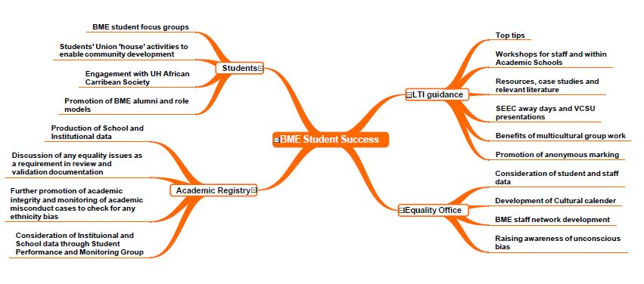
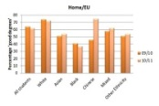
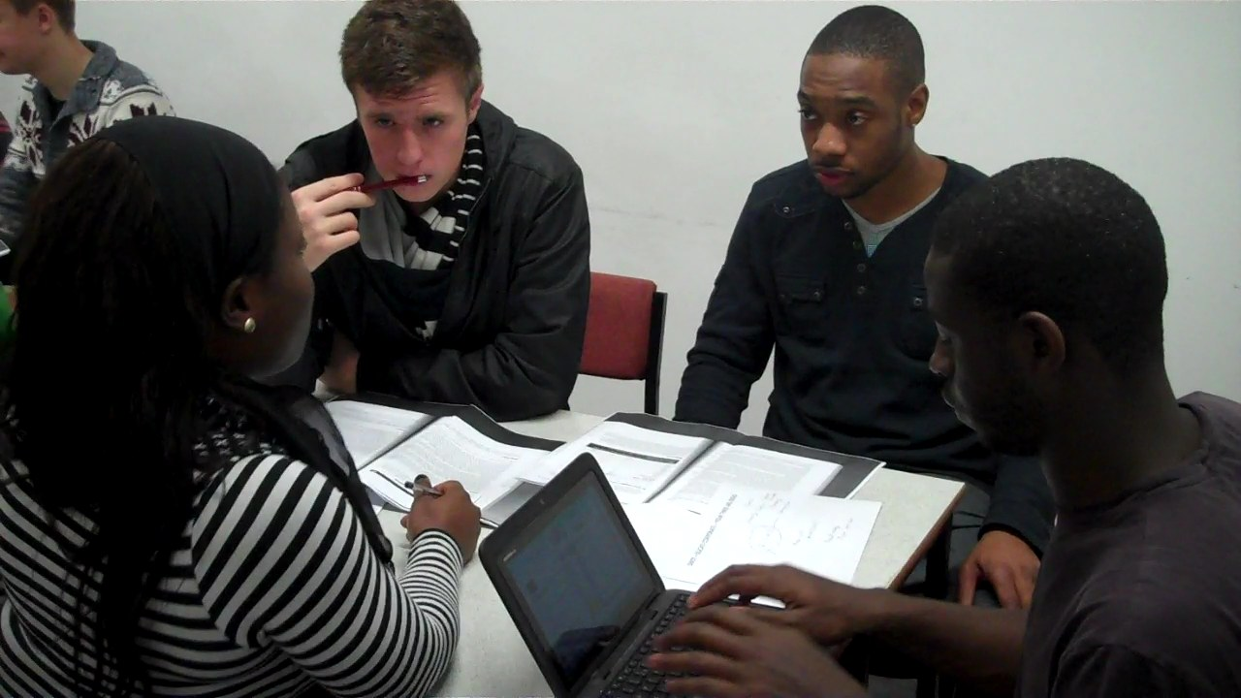
"No one can do everything, but everyone can do something” – the journey to closing the attainment gap
Nathan Ghann, n.1.ghann@herts.ac.uk @nathanghann
Helen Barefoot, h.barefoot@herts.ac.uk @helenbarefoot #BMESuccess
Notes:
Helen

Slide 2
Post 1992 institution
Overall BME population 46%
Notes:
Helen

Slide 3
Our journey so far
Notes:
Helen
OVC commitment
Equality Objectives 2012 Reduce/Increase
700 staff attended unconscious bias workshop
Schools given access to their data
Race Equality Chartermark Bronze award
BME Success Working group
Over last 5 years have reduced gap by 10%

Slide 4
Notes:
Helen
Gap in 2016/17
White = 74
BAME = 57
Gap of 17%

Slide 5
Notes:
Helen

Slide 6
Current activities
HEFCE Collaborative
Project (Value added data)
LFHE for Programme Leader Project
BME Student Advocates
BME Staff Network
Close relationship with HSU
BME SUCCESS WORKING GROUP
Notes:
Helen

Slide 7
What do you think might be some of the reasons for the attainment gaps?
Discuss possible reasons with the person next to you and the please post a thought/possible reason on to the Menti site - Menti.com and use the code 76 70 83
Notes:
Nathan

Slide 8
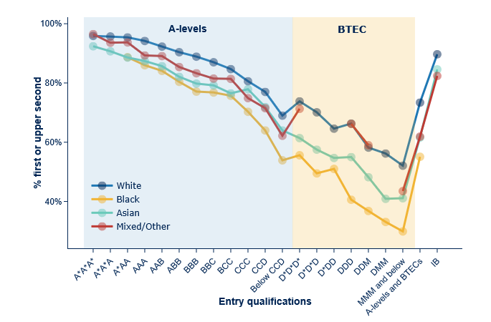
Office for Students (2018)
https://www.officeforstudents.org.uk/data-and-analysis/differences-in-student-outcomes/ethnicity/
Notes:
Nathan

Slide 9
HEFCE/Office for Students funded project
6 partners
Notes:
Nathan

Slide 10
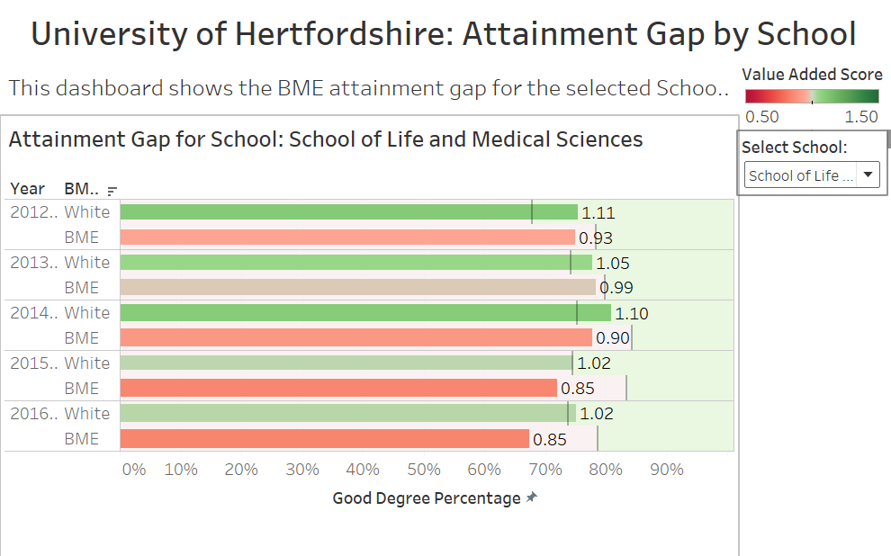
The Value Added score takes into account entry qualifications and subject choice, enabling comparison of statistically expected attainment and actual attainment for White and BME cohorts. The expected value added score is always 1.0 and scores higher than 1.0 suggests performance beyond the expectation, whereas scores below 1.0 suggests performance under what was expected
Notes:
Nathan

Slide 11
Notes:
Nathan

Slide 12
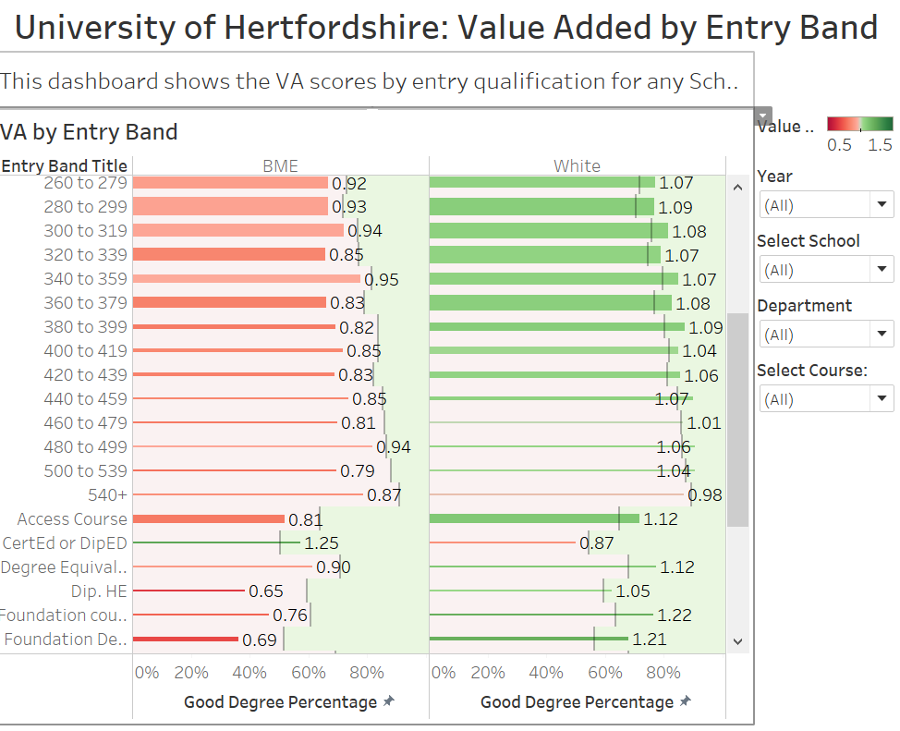
Notes:
Nathan

Slide 13
UH Value Added Scores
Gap = 0.28
Gap = 0.25
Gap = 0.20
Notes:
Nathan

Slide 14
Inclusive practice sessions
230 staff both academic and professional service teams
37 degree programmes + central professional teams and students
Action plans developed with progress support for each Programme team
Notes:
Nathan
Helen

Slide 15
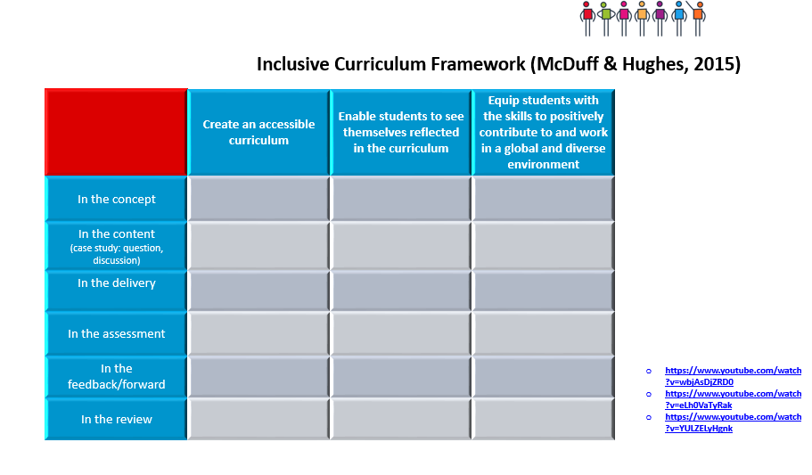
Inclusive teaching workshops
Aim: To support academic leadership at the programme level to enable inclusive curriculum enhancements and subsequent improvements in outcomes for students from Black and Minority Ethnic (BME) backgrounds
Notes:
Helen

Slide 16
Leadership Foundation project work:
Interviewed 30 programme leaders
Transcribed the interviews and analysed the data
Development of 11 case studies from a range of programmes
Reviewed AMER actions plans to look for actions to reduce the BME attainment gap
Follow up phone interviews
Notes:
Helen

Slide 17
Effecting programme level change
In depth understanding of challenges
Identified clear actions to influence change across the programme
Personal commitment to inclusivity
Workshop stimulated personal change in own practice (e.g. in interactions with students, in own teaching, within their module)
Limited actions
New to discussions of race and lack of awareness of data
Distraction / discussion of other issues such as gender equality
Previous engagement in training and awareness of national / local / discipline specific data
Changes to own practice
Identified needs for enhancements
Difficulties in influencing wider team (e.g. challenge of leading without line management responsibility and time pressures)
Deficit approaches which solely focus on student support
Worried and not knowing really where to start
Notes:
Helen

Slide 18
Case studies
Arranging whole team meetings which focused on presentations and discussions on BAME attainment
Challenging module leaders to review their module reading lists to include more BAME authors
The inclusion of BAME role models within the teaching materials/and or the inclusion of guest lecturers from BAME backgrounds
Promotion of diversity and leadership schemes to students
The communication to all students of a belief in their abilities and the promotion of self efficacy
Discussing critical race theory within their own teaching, including recognising their own privilege
Promotion of unconscious bias workshops for staff teaching on the programme and subsequent open discussions about race
Developing the confidence of programme team members to enable them to talk explicitly about race within the context of their disciplines
Developing a better understanding of barriers for BAME students through working with BAME student advocates
Notes:
Helen

Slide 19
Barriers to change
Hidden data
Competing priorities
Deficit, Deflection, Defeatism
Notes:
Nathan

Slide 20
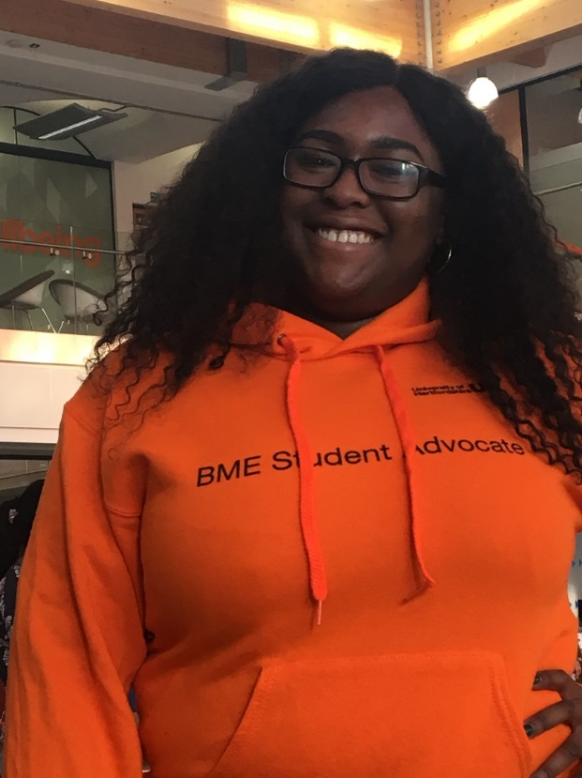
BME Student Advocates
BME Student Advocates
Represent the BME student voice
Support curriculum reflection exercises
Notes:
Nathan

Slide 21
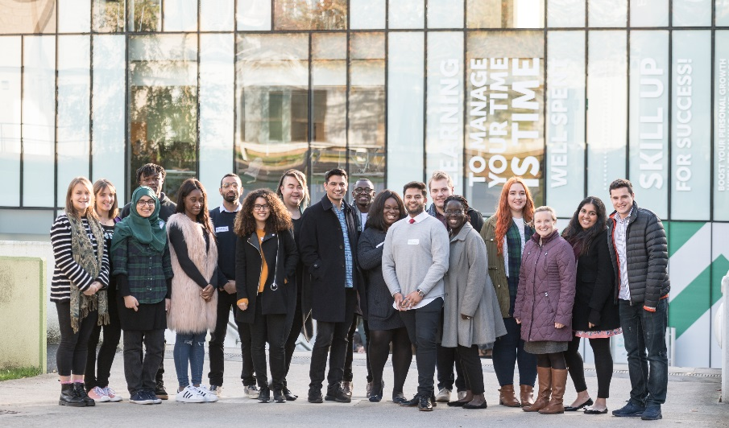
Working in partnership with our SU
“The BME Success working group has proven to be the most gratifying project of my year of office. It gave me the opportunity to work on a project bigger than myself by looking at solutions for our diverse student population.”
Sarah Kwedi, VP Education
Notes:
Nathan

Slide 22
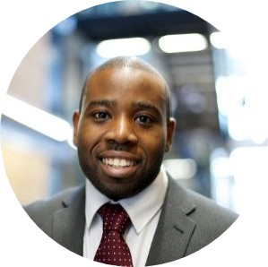
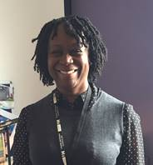
BME Staff Network
Identify as a need from self assessment team from the race equality charter
Diverse and representative body of both academic and professional staff
Supporting university in it’s Equality Objectives
Notes:
Nathan

Slide 23
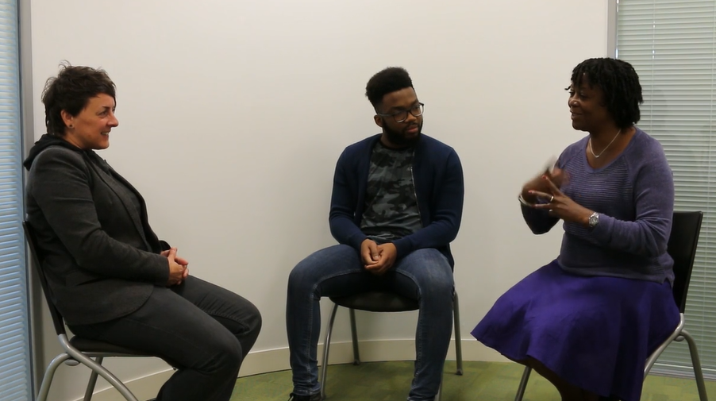
Staff and Student Experiences
https://vimeopro.com/user36612354/bme

Slide 24
What next?
Working with Student Union to further disseminate data and capture student voice
Supporting Programme Leaders whilst recognising the challenges they face locally
Develop a tailored session for middle management – Line managers / delegated responsibility
Sessions with staff in our professional and technical teams (careers, admin, marcomms, study abroad)
Resubmission of Race Equality Charter
Notes:
Nathan

