Slide 1
Course Enquiry Team

Slide 2
December Overview
Contact Methods | Totals
Phone calls | 770
Cases (email and webforms) | 437
Live Chats | 117

Slide 3
KPI Performance
*Achieved YTD is usually calculated September-Aug. Please note we only have data since April (this is when we implemented feedback options). YTD data will be from April-Sept 23.
KPI | 2022/23 KPI Target | Achieved date | Achieved YTD (Year Sept-Aug 22)
Calls answered in 30 seconds | 85% | 100% | 100%
Calls lost in 30 seconds | >10% | 0.3% | 100%
Customer Satisfaction Rating Phones | ≤3 out of 5 | 4.3 | 100%
Customer satisfaction form (all services) | ≤3 out of 5 | 4.5 | 100%

Slide 4
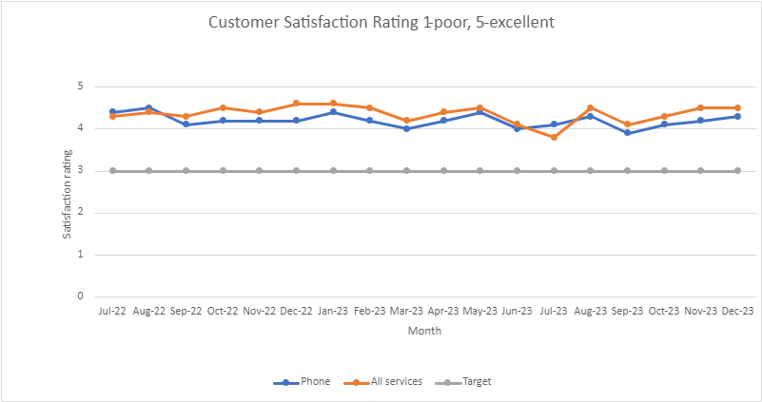
Customer Satisfaction
*Our telephony average excludes transferred calls and calls answered with a duration of less than 10 seconds - (less than 10 second calls can be wrong numbers, failed calls, quiet lines). Transferred responses are not a representation of our service.
*Our customer satisfaction ratings are recorded out of 5. Questions asked: how to you rate your customer service, 1 being poor, 5 being excellent? We take an average of our responses monthly.
Phone: telephony feedback form.
All services: a feedback form sent to those added as contacts on our CRM or accessed on our contact us webpage. This asks for ratings on timeliness and customer service.

Slide 5
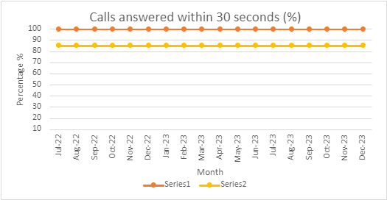
Call Response Time
*Call response times are taken when the call has rooted through to an operator and the telephone starts ringing. Our target is to answer 85% of calls within 30 seconds of ringing.

Slide 6
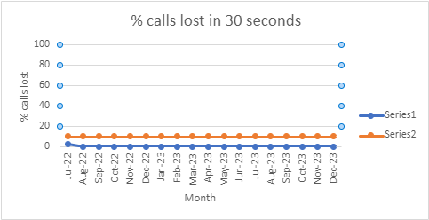
Calls Lost
*Call lost are calls we lose before rooting through to an operator and ringing. This can be from waiting in a queue while an operator is busy, or while listening to our automated telephony response. Our target is to stay below 10% calls lost in under 30 seconds.

