Slide 1
Anonymous Marking An overview for students

Slide 2
ANONYMOUS MARKING: WHAT IS IT?
Student’s name and any other identifiable information is hidden from staff who mark their assessments/reassessments.
Students do NOT put their names on work submitted, only student ID
Not all assessments are concerned, only via Turnitin (table of types of assessments in the Anonymous Marking Policy)
Does not prevent Special Arrangements from being highlighted to markers

Slide 3
ANONYMOUS MARKING: WHY DO IT?
Provides additional reassurance to students that marking is conducted fairly and impartially
Practice widespread across UK Universities as well as in other sectors (e.g. recruitment)
Sometimes staff will be able to identify who submitted (small cohort, reassessment, etc.)
Valid reasons for when staff will check student ID (e.g. submission to wrong place, suspected academic misconduct).

Slide 4
YOUR EXPERIENCE OF ASSESSMENTS
Feedback given on formative work (i.e. which takes place throughout the module)
One exception: final draft used for authenticity check only is submitted anonymously (no feedback provided)
NO change in relation to what is taught, how it is taught, on how you are assessed. The learning process remains “as usual”.
Focus on marking criteria is done during assessment preparation so that students understand feedback

Slide 5
WHAT IT MEANS FOR THIS COURSE MODULE
Insert info on assessments included in anonymous marking, module by module, explaining why those assessments not included are not included. Refer to your module handbooks where students can find more information.

Slide 6
ANONYMISING YOUR WORK
Use Student ID in all of the below:
Header of document (or equivalent)
File name when saving
Title on Turnitin Box
Remember to use your student ID, not your name
If you started your studies in 2020 or later:
use all 9 digits, e.g. 100034447
If you started your studies before 2020:
ignore first three letters and retain 8 numbers, e.g. TAY85530012

Slide 7
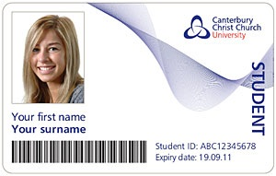
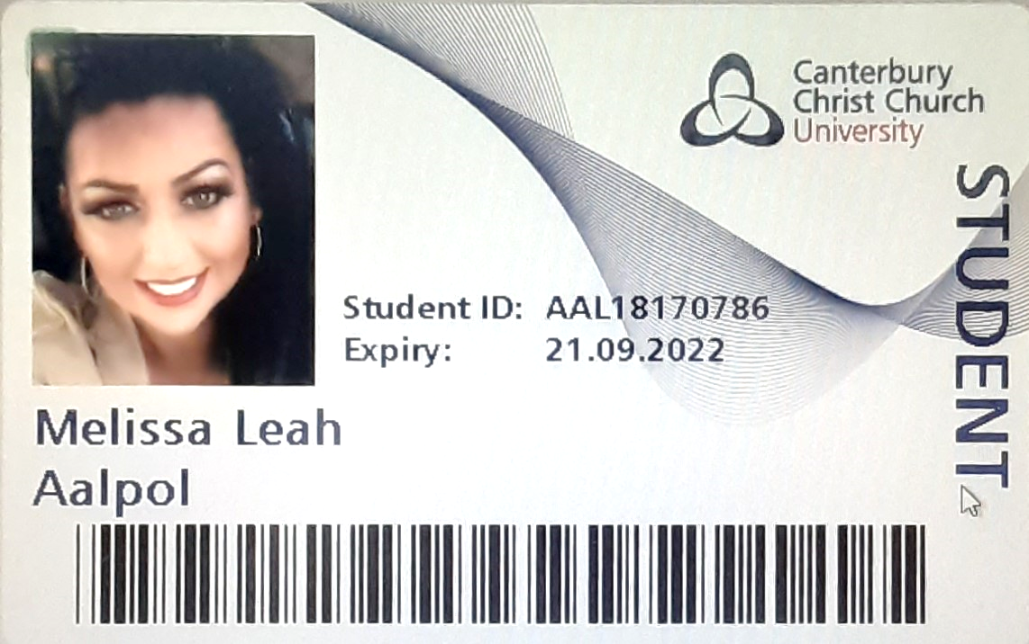
EXAMPLE STUDENT CARDS
12345678
Bruce
Stanley
987654321
987654321

